Slide 1
Help!
Melissa Henley
Director of Marketing Communications

Slide 2
What You’ll Learn Today
What resources are available from Laserfiche
What CPP certifications are right for you
What you’ll get out of Empower 2015

Slide 3
But First … What’s New?

Slide 4
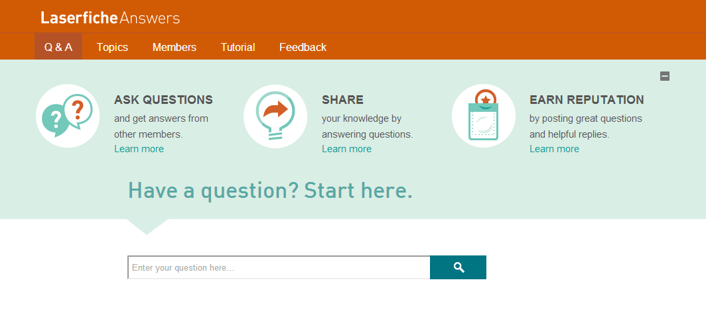
answers.laserfiche.com

Slide 5
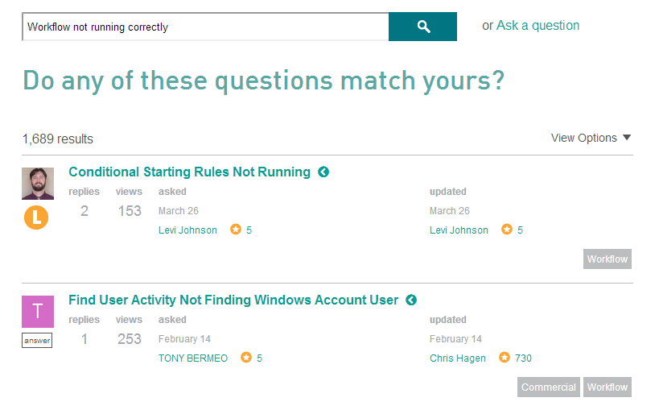

Slide 6
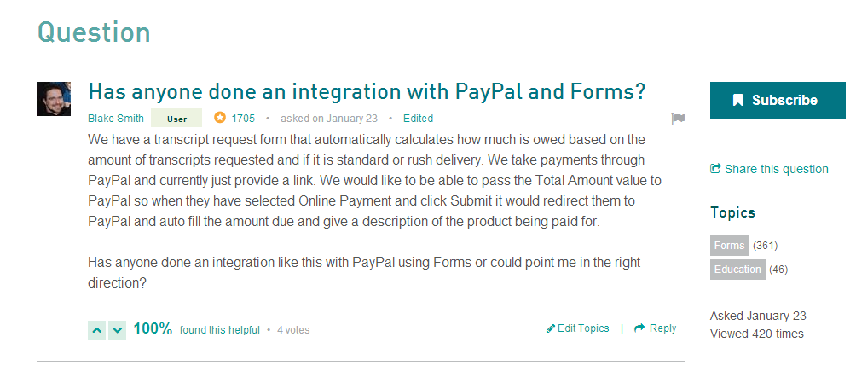

Slide 7
How Do I Get Started?

Slide 8
Know What You Are Looking For
What are you trying to do?
Where are you?
When do you need help?
Notes:
Before you get started, you need to know what you are looking for. Some things to note are:
What are you trying to do? What do you want to configure?
Where are you? Where are you in the product, what product are you in?
When do you need help? Is it when you’re configuring something, or is it when you get a certain error message?
Once you define your problem and know specifics, then you’re ready to go!

Slide 9
The Laserfiche Support Site

Slide 10
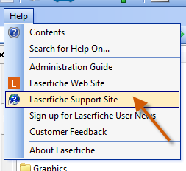
Sign Up for the Support Site
Laserfiche 8.3 and higher will automatically populate your serial number on the Support Site Registration page the first time you click “Laserfiche Support Site” from the Help drop-down menu
Notes:
If you are running Laserfiche 8.3 or earlier, get your serial number (about LF box)
Laserfiche 8.3 and higher will automatically populate your serial number (on the Support Site Registration page) the first time you click “Laserfiche Support Site” from the Help drop-down menu.

Slide 11
Get Logged In!
Notes:
Make sure you are logged in! The Support Site looks the same whether you are logged in or logged out.

Slide 12
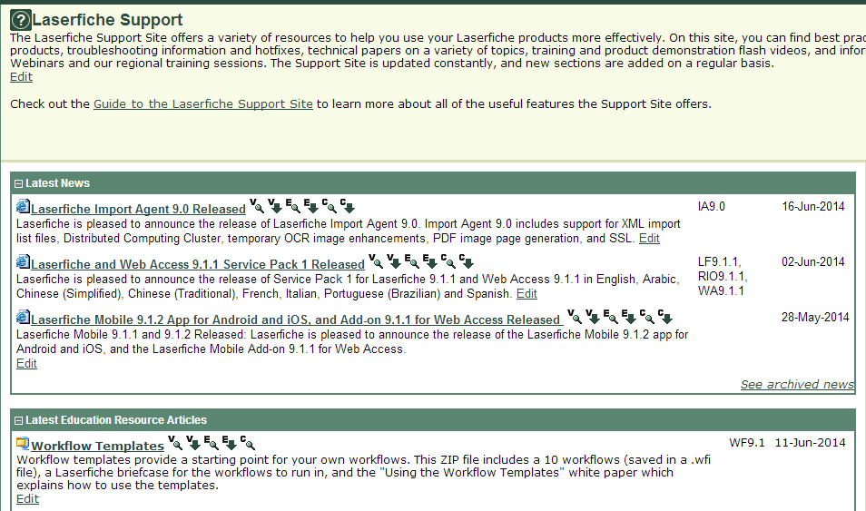
Notes:
The Laserfiche Support site offers a wide variety of information, such as best practices, tips, troubleshooting, hotfixes, technical papers, and tutorial videos. You can also find information about our online Webinars and regional trainings.
The Support Site is active! This is where the we post new material and have community discussions (forums).
See also, the Product Roadmap link located at the bottom of the “Selected Product” pane (right-hand side)

Slide 13
Support Site Resources
Technical papers: Detailed information
Knowledge Base (KB) articles: Product specifications, error handling
Videos: Demonstrations and tutorials
Laserfiche Answers: Ask questions, get answers
Trainings: Advance your knowledge
Notes:
In the Knowledge Base tab, the Featured Articles section shows a few very important KBs. Open the Current Release Versions KB to see the most recent versions of the products.
In this KB, there are links for each Laserfiche product. Typically, these are links to the List of Features and the Release Notes KBs. These KBs give detailed information about a specific version of the product.
1. Release Notes: Summary, System Requirements, and Compatibility information
2. List of Features: Details about the whole product, what you can do with it, how you interact with it, and what solution it contributes to the Laserfiche suite.
LF Answers – post feature requests

Slide 14
Product Help Files

Slide 15
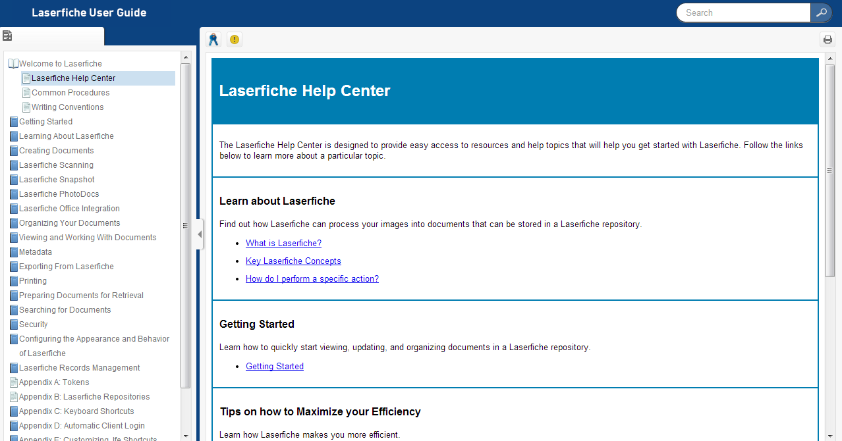
They’re Really Helpful!

Slide 16
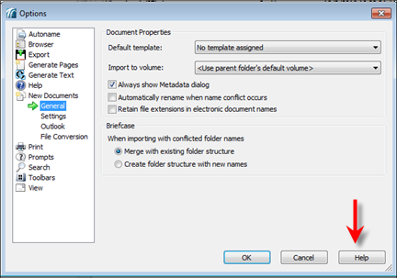
Find Them Here …
F1
Buttons/icons/menus
Context buttons
KB 1012253
Notes:
Many ways to get to them:
F1—in pretty much any Windows program anywhere
Big, shiny help button in toolbar
Help menu at top of screen
Context help on different dialog boxes

Slide 17
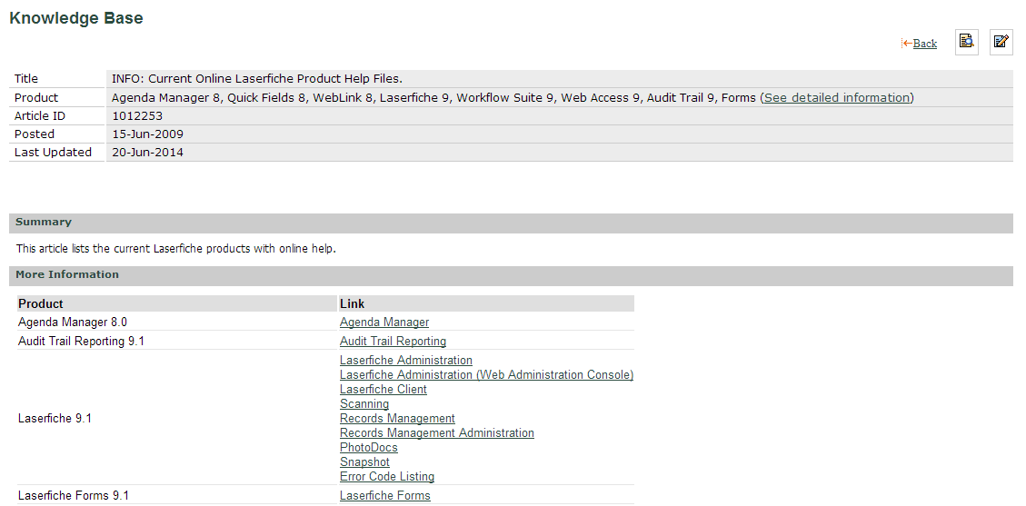
https://support.laserfiche.com/KB/1012253

Slide 18
The Laserfiche Solution Exchange
laserfiche.com/
solutionexchange

Slide 19
Learn From the Community
Share solutions, tips and tricks
What have others done?
160+ real results that you can learn from

Slide 21
Quicker Better Safer
Written to help both newer and long-time Laserfiche customers across industries get the most out of the software
Covers how to use Laserfiche for common processes such as accounts payable, case management, contract management and much more

Slide 22
Quicker Better Safer: Higher Education
Ten institutions share how to streamline:
Contract management
Student loan processing
Financial aid processing
Records management
Admissions
And more!

Slide 23
Quicker Better Safer: Accounts Payable
Screenshots and diagrams alongside detailed, step-by-step instructions provide an in-depth look into how ten organizations streamlined the accounts payable process with Laserfiche

Slide 24
Quicker Better Safer: HR
Screenshots and diagrams alongside detailed, step-by-step instructions provide an in-depth look into how ten organizations streamlined human resources processes with Laserfiche

Slide 25
Quicker Better Safer: Laserfiche Forms
Learn how to set up and configure Laserfiche Forms for ten daily business processes, including:
Purchase orders
Travel requests
Employee hiring and onboarding
Employee evaluations
New customer onboarding

Slide 26
Quicker Better Safer: Laserfiche Mobile
Learn how to:
Implement Laserfiche Mobile within your organization
View agendas on iPads
Participate in business processes on the go
Configure Laserfiche Mobile security
And more!

Slide 27
What Would You Like to See Next?
Records Management?
Best Practices?
Getting Started?
Email joanna.slusarz@laserfiche.com

Slide 28
The Certified Professional Program

Slide 29
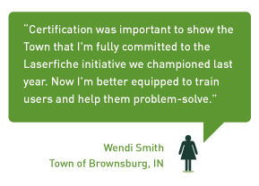
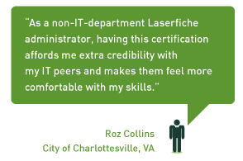
Why Get Certified?

Slide 30
If I Can Do It …

Slide 31
How Does it Work?
Series of self-paced online training videos
Comprehensive training manual
Two opportunities to take the online exam

Slide 32
What Certifications are There?
Getting Started
ECM 101
Laserfiche Specialist
Content & Process Management
Repository Architect
BPM
BPM II: Laserfiche Forms
Capture I
Capture II: Quick Fields
Capture Workflow
System Administration
Laserfiche Administrator I
Laserfiche Administrator II
Advanced Security
Records Management Edition I
Troubleshooting
Laserfiche Integrator I

Slide 33
What Certifications are Right for Me?
Scanner/Operator:
Capture I & II
Laserfiche Specialist
Capture Workflow
BPM*

Slide 34
What Certifications are Right for Me?
Super User:
ECM 101
Laserfiche Specialist
Capture Workflow

Slide 35
What Certifications are Right for Me?
Records Manager:
Records Management I
Laserfiche Specialist

Slide 36
Laserfiche Admins: Go for the Gold!

Slide 37
Stay Tuned …
All-new Laserfiche Integrator
More classes updated for Laserfiche 9

Slide 39
What’s new?
Anaheim Convention Center Campus
Anaheim Marriott and Anaheim Sheraton
Tuesday classes
New class topics

Slide 40
Networking Opportunities
Welcome Reception
Texas User Group
“Birds of a Feather” Lunches
Special Event
Run Smarter reception

Slide 41
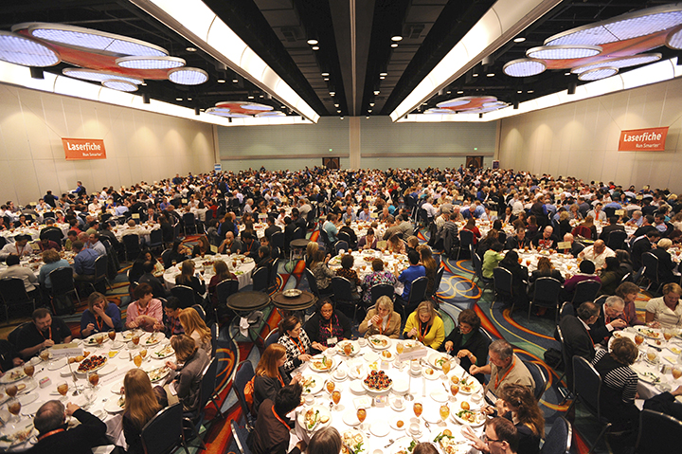
See You in Anaheim!

Slide 42
Takeaways
Know what help is available
Know how to look for things
Know who to ask
Learn more about products and features

Slide 43
Questions? Melissa Henley melissa.henley@laserfiche.com (562) 988-1688 x230

