Slide 1
Using the Laserfiche UI in Your Integration

Slide 2
Objectives
How Laserfiche UIs can be used
Which UI should you use
How to build web integrations
How to build desktop integrations
Notes:
What are they going to learn from you?
If it’s not what they want, better to know now

Slide 3
Why Use the Laserfiche UI?

Slide 4
Benefits of the Laserfiche UI
It already exists
Familiar and powerful
No additional training necessary
Notes:
List what you will cover in the course.

Slide 5
Built-In Tools

Slide 6
Built-In Tools
Easy to configure
Free (mostly)
Powerful

Slide 7
Database Integration
Quick Fields
Workflow
Forms

Slide 8
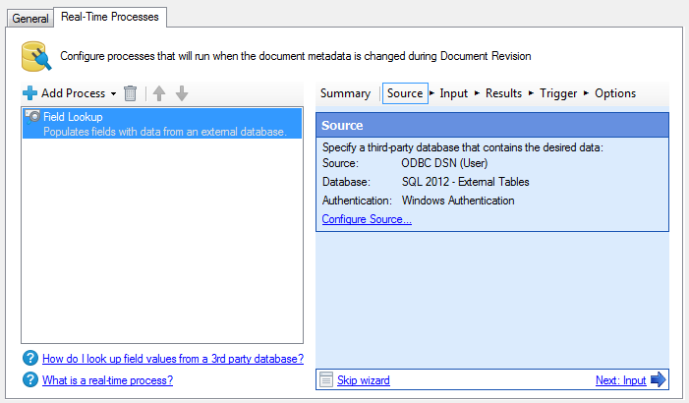
Quick Fields
Pull information from a database
Verify captured data against a database
Most useful at point of capture

Slide 9
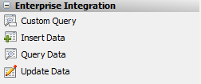
Workflow
Pull information from a database
Verify captured data against a database
Update data in a database
Insert new data in a database
Useful at any point

Slide 10
Forms
Pull information from a database
Pass information to Workflow
Simplify data entry

Slide 11
Other Options
Snapshot
Import Agent
PDF activities

Slide 12
Advanced Options
Workflow Web Service
Pass data and parameters
Custom Scripts/Activities
Make Workflow or Quick Fields do new things
Can use SDK, but don’t have to

Slide 13
Resources
Courses:
BPM204: Workflow Integration Strategies
BPM302: Connecting Workflow to the World
CC208: Intermediate Quick Fields
Whitepapers:
Custom Activities in Workflow (C#)
Custom Activities in Workflow (VB.NET)
Consuming the Workflow Web Service

Slide 14
Integration Marketplace

Slide 15
Integration Marketplace
Library of plug and play integrations
Built by development partners
Cost-effective

Slide 16
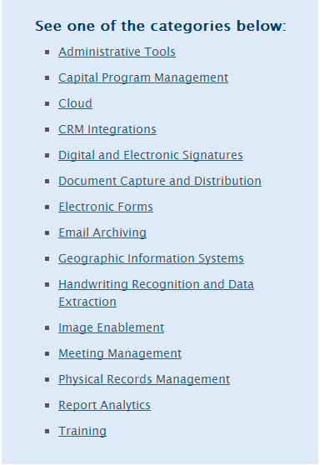
Integration Marketplace
Cool integrations:
Automatic email import
CRM software
Screen scraping

Slide 17
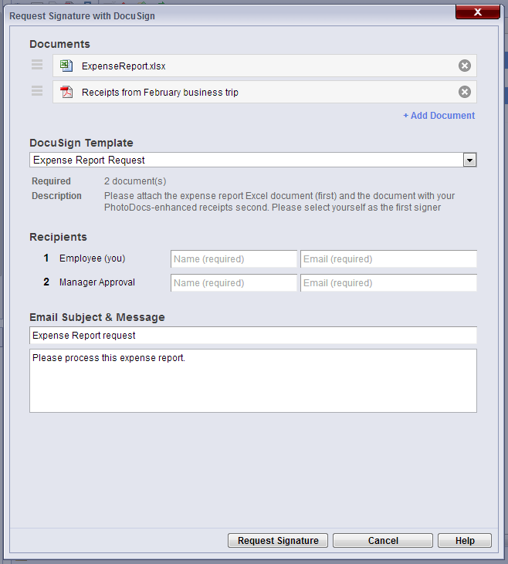
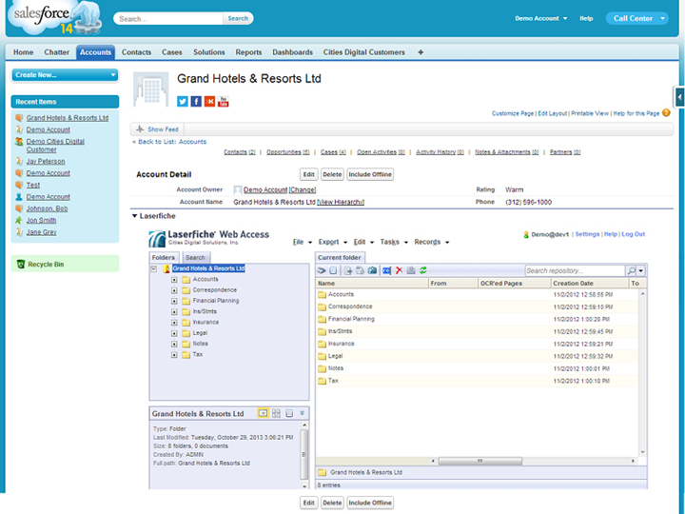
Sample Integrations

Slide 18
Resources
Integration Marketplace
Marketplace Partners

Slide 19
Web vs. Desktop Integrations

Slide 20
Defining Terms
Web = typically URL
Desktop = mostly CAT
Notes:
List what you will cover in the course.

Slide 21
Web Integrations
Convenient for other web apps
Usable when off-site
Easier to build
Notes:
List what you will cover in the course.

Slide 22
Desktop Integrations
Work well with other desktop apps
Provides deep level of control
More challenging to code
Requires desktop Client
Notes:
List what you will cover in the course.

Slide 23
Web Integrations

Slide 24
Web Access vs. WebLink
Web Access:
Allows read/write access
Convenient for internal use
WebLink:
Read-only client
Highly customizable
Streamlined interface
Notes:
List what you will cover in the course.

Slide 25
Features
Embed web clients in your application
Control Laserfiche web clients via URL
Search the repository
Open entries
Notes:
List what you will cover in the course.

Slide 26
The Possibilities
Search the Laserfiche repository
Add a search box to your application
Launch a pre-defined or templatized search
Open entries
Documents
Folders
Launch Web Scanning
Notes:
List what you will cover in the course.

Slide 27
The Basic Idea
Programmatically create WA / WL URLs
Embed those URLs in third-party apps
Notes:
List what you will cover in the course.

Slide 28
Necessary Supplies
Web coding experience
Integratable third-party application
Web Access Help Files
WebLink Help Files
Advanced Search Syntax Whitepaper
Notes:
List what you will cover in the course.

Slide 29
Web Access - Documents
http://localhost/laserfiche/index.aspx?
db=LaserInvestigators#
id=1878;
View=metadata
Mode=officeplugin
Action=checkout
Notes:
List what you will cover in the course.

Slide 30
Web Access - Searching
http://localhost/laserfiche/index.aspx?
db=LaserInvestigators#
search=searchquery;
view=search;imageenable=true

Slide 31
Web Scanning
lfwa80://scanning/<LocationOfScanningService.asmx>?<custom parameters>

Slide 32
WebLink - Documents
http://localhost/WebLink8/DocView.aspx?dbid=0&id=1878
http://localhost/WebLink8/DocView.aspx?dbid=0&id=766&page=2
http://localhost/WebLink8/DocView.aspx?dbid=0&id=1934&openfile=true

Slide 33
WebLink - Searching
http://localhost/WebLink8/Search.aspx?
dbid=0&searchcommand=searchquery
Make sure to URL encode your query!

Slide 34
Desktop Integrations

Slide 35
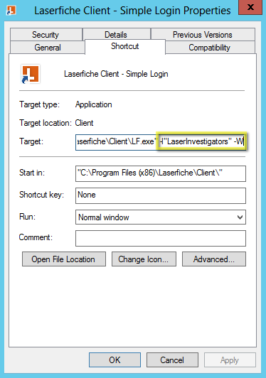
Client Command Line
What you can do:
Login as particular user
Run a search
Open a document
Notes:
- The simplest way to use the client in your integration.
- No programming involved.

Slide 36
Client Command Line
Launch the client and login automatically using domain authentication:
LF.exe -l"LaserInvestigators" -W
Notes:
- Can also specify LF username/password (not recommended)

Slide 37
Client Command Line
Opening a document by ID and view it in the Metadata dialog:
LF.exe -l"LaserInvestigators" -W –E1930 -M0
-E specifies entry ID
-M:
0: Metadata Dialog
1: Document Viewer
2: Electronic File
3: Electronic File (read-only)
Use folder ID to go to that folder
-r makes the folder the root of the tree

Slide 38
Client Command Line
Run a search with –S
LF.exe -l"LaserInvestigators" -W -S"{[Case Files]:[Case ID]=\"7654\"}"
Note: don’t forget to escape quotes

Slide 39
Client Command Line
Command Line Reference:
http://www.laserfiche.com/support/webhelp/Laserfiche/9.0/en-US/UserGuide/Laserfiche_Client.htm#Appendix_D_Command_Line_Parameters.htm

Slide 40
LFE Shortcuts
Laserfiche shortcut files
Launches the client and performs an action:
Open specific folder/document
Run a search
Checkin/checkout documents
Notes:
More advanced than command line functionality.

Slide 41
LFE Shortcuts
Create by:
Drag out of the client while holding CTRL-Shift
Workflow E-mail activity
Simple XML Format:
Notes:
XML=Portable and easy to create yourself.

Slide 42
LFE Shortcuts
Configure Repository and Login
Add server element in case the repository hasn’t been used before
Notes:
Can also specify username/password for LF account (not recommended)

Slide 43
LFE Shortcuts
Open a document
Mode:
0: Metadata Dialog
1: Document Viewer
2: Electronic File
3: Electronic File (read-only)
Use makeroot=‘y’ to open folder as root of the folder tree

Slide 44
LFE Shortcuts
Launch search
Notes:
Don’t forget to escape XML characters

Slide 45
LFE
LFE Reference:
http://www.laserfiche.com/support/webhelp/Laserfiche/9.0/en-US/UserGuide/Laserfiche_Client.htm#cshid=Appendix_E_Parameters.htm

Slide 46
Introduction to CAT
.NET library for controlling the Laserfiche Desktop Client
New to Laserfiche 9
Included with the 9.0 SDK
“ImageEnable++”

Slide 47
Uses for CAT
Launching the Client
Finding and using open instances of the Client
Launching Scanning
Opening documents
Running searches
Adding custom buttons to the Client
Retrieving the Client’s connection
Finding out what document is open or selected
Silently printing/exporting
And more…

Slide 48
Class Layout
ClientManager: Master class
ClientInstance: Represents a single LF.exe
ClientWindow: Represents a main window or doc viewer
MainWindow
DocViewer
RepositoryConnection: A single Laserfiche connection
One MainWindow can have multiple RepositoryConnections
Notes:
Talk about background of ImageEnable???

Slide 49
Want Sample Code?
9.0 SDK Documentation:
C:\Program Files\Laserfiche\SDK 9.0\Samples\ClientAutomation Samples.zip
MonitorConsole: Reports details about open instances of the Client.
CustomButtonManager: Adds custom toolbar with various buttons that use CAT.
ScanningLauncher: Shows how to use CAT to launch scanning.

Slide 50
Programming with CAT
Add references
Import libraries
Create the ClientManager
Notes:
RepositoryAccess is for advanced uses, it isn’t needed to do basic CAT operations

Slide 51
Demonstration
Investigation Management System integrated with the Laserfiche Client

Slide 52
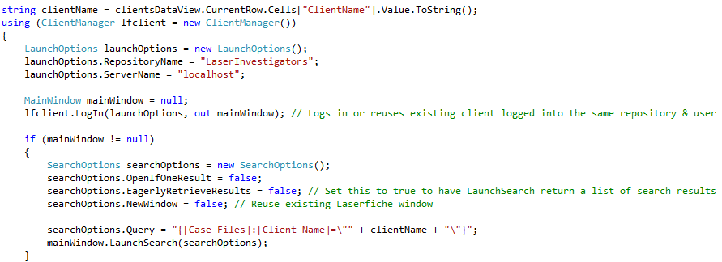
Launching and Searching

Slide 53
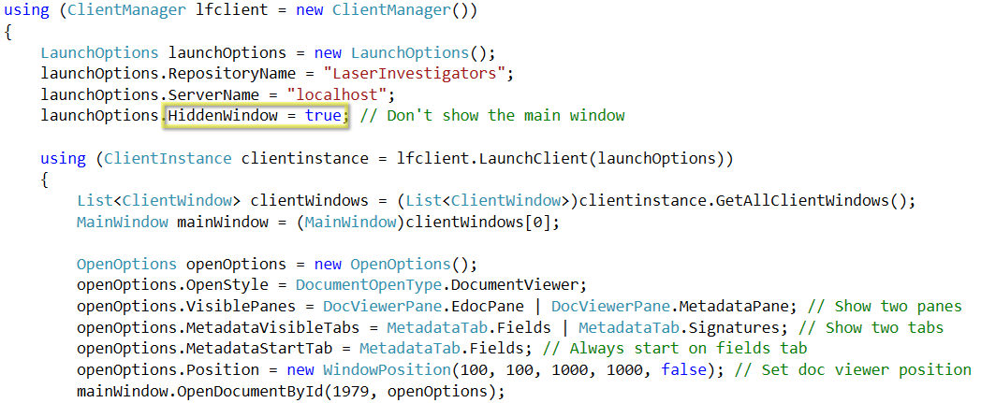
Opening Documents

Slide 54
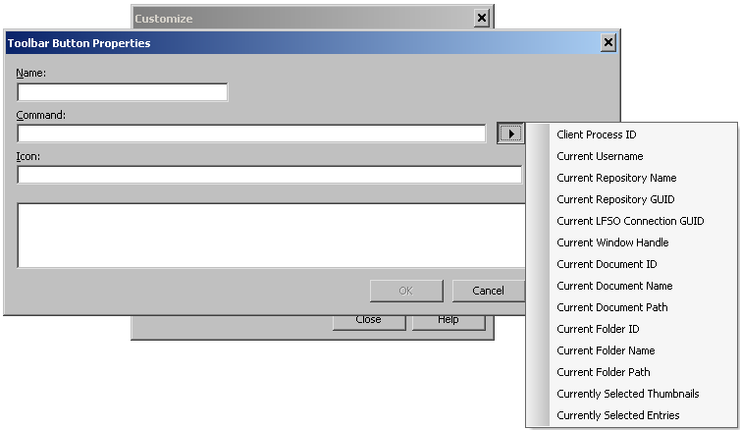
Custom Toolbar Buttons
Command line tokens tell your application about how/where it was launched.
Process ID
Window handle
Database name
Selected entries/pages
Document ID
… plus more

Slide 55
Adding Toolbar Buttons
See the sample code for this class.
See the CustomButtonManager sample project for advanced uses.

Slide 56
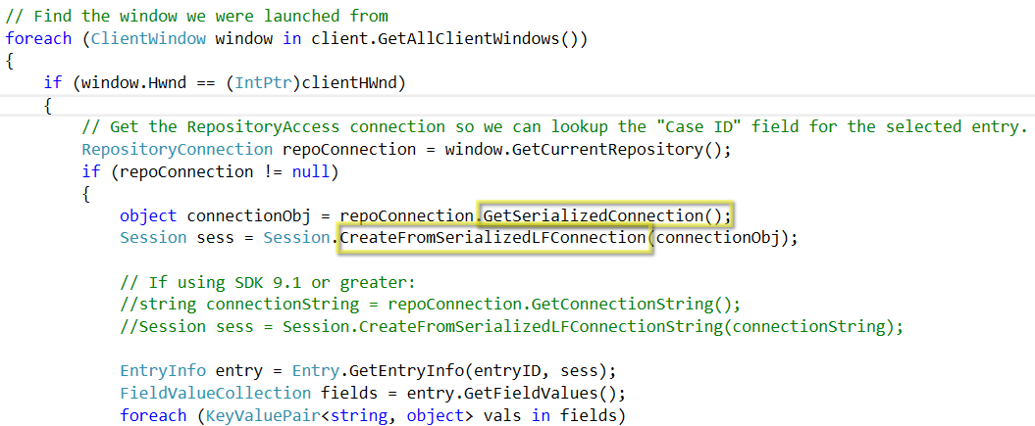
Using the Client Connection

Slide 57
Launching Scanning
ClientManager.LaunchScanning
Launches scanning without launching client
ClientWindow.LaunchScanningFromClient
Launches scanning within client
ScanOptions.CloseAfterStoring
Close Scanning when the user stores

Slide 58
Resources
Ken’s Customizing Web Stuff Classes
Topics
Advanced
Help Files
Whitepapers
Capture & Classification with the SDK
Notes:
List other courses, papers, videos, etc., relevant to your course material.
Other conference classes
CPP
Whitepapers
Other online resources for further learning

Slide 59
Questions?

