Slide 1
Getting Started with the Laserfiche SDK

Slide 2
Agenda
SDK overview
Demo
What you need to know to get started
Where to go from here
Notes:
In this class, we’re going to give you an overview of what the Laserfiche SDK is, what it is made of, what you can do with it, and walk through some examples to illustrate some best practices when creating SDK applications.

Slide 3
Prerequisites
Knowledge of Laserfiche architecture
Some programming experience
Notes:
Because this class is all about using the SDK to create applications that interact with the Laserfiche repository, to get the most out of this class you should be familiar with the Laserfiche repository and Server architecture. You should understand concepts like security and user management as well as things like what an entry is and what Laserfiche metadata is. These are concepts I’m not going to cover and that I expect you to understand.
In addition, because this is a course about creating applications, you’ll need some programming experience to get the most out of this course. The examples I will use are written in C#. If you don’t know C# but are familiar with a modern object-oriented programming language you should be able to follow along.

Slide 4
What is the SDK?
Tools you can use to create custom applications that access Laserfiche
  Libraries
  Distribution tools
  Documentation
Notes:
When we talk about the SDK, we’re often referring to its libraries: Repository Access, Document Services, CAT, etc. These libraries contain classes that make it easy to write applications that interact with the repository or the client itself.
These libraries aren’t just something we built for the SDK: they’re the same internal libraries our developers use to make all of our products and we’re giving them to you. Things like the Laserfiche Client, Workflow, Forms are built using the SDK.
The SDK is more than a collection of useful libraries; it contains distribution tools you can use to ensure that your application has the references it needs when you deploy it and it contains documentation to help you when you’re writing your application.

Slide 5
What Can You Do with the SDK?
Create applications that work with…
  The repository
  Documents
  The Laserfiche Client user interface
Notes:
With the SDK, you can create applications that access the Laserfiche repository, create and manage users, administer security, create entries, apply metadata, modify the Laserfiche Client’s UI, and more. The SDK is what our developers use internally, so we’re giving you all the tools you need to successfully integrate with the Laserfiche repository.

Slide 6
SDK Libraries

Slide 7
SDK Libraries
.NET
  Repository Access
  Document Services
  Client Automation Tools
COM, Java libraries available
Notes:
Now let’s go over the libraries available in the SDK. For the purposes of this course, we’re going to focus on the newer .NET libraries present in the SDK.
The SDK does include COM libraries, like LFSO and Document Processor. But, if you’re new to building SDK applications and you’re working in a .NET environment, you probably shouldn’t need to worry about using the COM libraries.
There’s also a Java version of Repository Access. It’s there if you need to use it, but it isn’t the focus of this course.
Although we’re going to focus on the .NET libraries, it’s important to note that the same fundamental concepts apply in .NET and COM. The .NET libraries are simpler to use and are what Laserfiche is using going forward, so that’s what we’re going to teach you in this course.

Slide 8
Repository Access
Connections
Metadata
Entries
Administration
Notes:
As the name implies, Repository Access is the .NET library that contains the classes you’ll need to access the repository and its contents. You’ll use Repository Access to create connections to the Laserfiche server, to manage metadata, to create, modify, and delete entries, to administer security, manage users, and more.

Slide 9
Document Services
Import/Export documents
Generate text
Notes:
Document Services is an incredibly helpful library that makes it easier to import and export documents, as well as generate text. While these activities are possible to accomplish using only Repository Access, using Document Services makes performing these actions more straightforward.

Slide 10
Client Automation Tools
Control UI
Scan
Integrate Laserfiche and other applications
Notes:
Client Automation Tools, or CAT for short, is the library you’ll use when you want to control or access the Laserfiche Client’s user interface. Since the Client is a Windows app, it is much more difficult to customize the UI than it is with something like Web Access, a web application. CAT makes customizing the Client’s UI possible. If you’re familiar with LFImageEnable, CAT is the .NET successor to that. In addition, CAT is the only supported way to generate image pages from PDFs on import.
Let’s say you want to integrate the Laserfiche client with your own application or another application. Using CAT, you could add a button for your program on the Laserfiche Client’s toolbar. It works the other way, too. You could add a button that opens the Laserfiche Client in your other program.

Slide 11
Quick Demo!
Notes:
Now let’s take a look at a very basic SDK application demo. This isn’t the most realistic or exciting demo, but it is short and demonstrates many of the concepts we’re going to talk about.
This is a console application that takes the Entry ID specified by the user and returns the entry’s name and lists its fields and their values. This example uses the entry’s entry ID because it is a unique identifier for the entry and makes it straightforward to find and work with that particular entry. You might not always be initially finding an entry with its Entry ID, but using this value makes it easy to refer to an entry later on.
Let’s take a look in the repository and pick a document. Here’s one. I’ll right-click it and open its properties to see its entry id. If we open the document’s metadata, we can see its fields and their values. Now I’ll open the SDK application I wrote and see what it does.
I’ll enter the same Entry ID as we saw earlier on the document. You can see that the program returned the entry’s name and then its field information. It’s a basic application but it’s also a great place to start. Now, let’s look take a closer look at this application.

Slide 12
Demo Overview
Logging in and out
Working with entries
Modifying field values
Locking and saving
Searching

Slide 13
Basic Demo Recap
Returned name and field values for an entry
Notes:
In that example we specified an entry ID and the program returned the entry’s name and field values. Pretty simple, right?

Slide 14
Behind the Scenes
Logged in
Found an entry
  Found its field information
Logged out
Notes:
Even though it is a very simple program, there’s a bit more than that going on in the code. First, the code logged in to the correct repository. Then, it found the entry we specified using the entry ID. Once it found the entry it returned its name and field information and when it was all done, it released the connection to the repository.

Slide 15
Demo Code
RepositoryRegistration myRepoReg = new RepositoryRegistration(“localhost", “LaserInvestigators");
Session mySess = new Session();
mySess.LogIn(myRepoReg);
Console.WriteLine("Entry ID:"); //asks for entry ID
int entryId = int.Parse(Console.ReadLine());
EntryInfo myEntry = Entry.GetEntryInfo(entryId, mySess); // get an entry
Console.WriteLine(myEntry.Name);
FieldValueCollection myFields = myEntry.GetFieldValues();
for (int i = 0; i < myFields.Count; i++)
{
Console.WriteLine(myFields.PositionToName(i) + ": " + myFields[i]);
}
myEntry.Dispose(); //disposes of the object
mySess.Close(); //logs out and disconnects from Laserfiche
Notes:
Here’s all of the code for the application. It’s a very simple program, but it’s easy to see that it is very concise and what it does is pretty self-explanatory from the class and method names.
Now we’re going to talk through some of the tasks you’ll all have to do as you write SDK applications using this code as an example.

Slide 16
Common SDK Tasks

Slide 17
SDK Building 101
Log in
Lock the documents to be worked on
Perform the actions
Save the changes
Release the locks
Log out
Notes:
As you create SDK applications, you’ll find yourself doing these common tasks repeatedly. You’ll create a connection the repository, lock documents, perform a task, save the changes to the document, release the lock when you finish with the document and release the connection when you finish working with the repository. In the next few slides we’re going to go over each of these tasks and show you how to do them.

Slide 18
Logging In
Create a Session() object
  Windows or Laserfiche authentication
  Can use SSL
  You’ll use this frequently
Notes:
When you log in to the repository, you’ll create a session object with arguments for the login credentials and repository. You’ll use this object a lot. You can pass this object around, so there’s no need to log in and out every time you want to do something.
As you might expect, you can use windows or Laserfiche authentication, and can use SSL. Let’s take a look at the code.

Slide 19
Logging In
RepositoryRegistration myRepoReg = new RepositoryRegistration("Server", "Repository");
Session mySess = new Session();
mySess.LogIn("username","password", myRepoReg);
To use Windows authentication, do not pass username/password to the .LogIn() method
Notes:
There are two things going on here. First, we’re creating a Repository Registration object that contains the server and repository we’re going to connect to. Next, we’re creating a Session object called mySess and using the login method to login with Laserfiche credentials to the repository specified by our repository registration object.
The login method is overloaded, so it takes a variety of arguments depending on what you’re trying to do. For example, to use windows authentication, you would not specify login information.
It’s important to note that the user you’re logging into the repository with is a user, so security and licensing considerations still apply here. You should make sure that the user you’re logging in with has the appropriate security and license necessary to do what you’re trying to do.

Slide 20
After Logging In…
Work with
  Templates
  Users
  Entries
  And more
Notes:
Once you’ve established a session with the server, you’re ready to start doing the real work of your application, whatever that may be. For this example, we’re working with an entry but keep in mind that you could also work with users, metadata and a lot more.

Slide 21
Working with Entries
Use a static class to create an info object
  Many methods available
Use Entry class to get EntryInfo object, use Document class to get DocumentInfo object, etc.
Notes:
Our demo application used an entry ID to return an entry’s name and its field information. To work with an entry, you’ll use the Entry static class to create an EntryInfo object. An entry info object corresponds to a specific entry in the repository. The same principle applies to other things, like documents, templates, and fields. When you work with these things, you’ll create an info object from a static class.

Slide 22
Working with an Entry Object
EntryInfo myEntry = Entry.GetEntryInfo(entryId, mySess);
Console.WriteLine(myEntry.Name);
Other properties include:
.Id, .Owner, .Path, .TemplateName
Notes:
As you can see, we’re creating an Entry Info Object called myEntry using the Entry static class. Notice that we’re passing the ID we captured from the user and the session we created into the .GetEntryInfo method to create this object.
Once we have the entryinfo object, we write its name to the console using object’s the Name property.

Slide 23
Getting Field Values
Just like entries, there are objects that represent metadata
FieldValueCollection myFields = myEntry.GetFieldValues();
for (int i = 0; i < myFields.Count; i++)
{
Console.WriteLine(myFields.PositionToName(i) + ": " + myFields[i]);
}
Notes:
As I mentioned earlier, you can do a lot more than just work with entries. There are many classes available, and you should use the ones that make it easiest to do what you’re trying to do.
For example, in order to get the field values for this entry, I’m creating a Field Value Collection object called myFields by using the .GetFieldValues method with my Entry object. A field value collection stores an indexed array of field values.
Once I have the field value collection, I can use the .Count method to get the number of fields and then iterate through the list, grabbing the field name and value at each index position and writing them to the console.

Slide 24
Summary
RepositoryRegistration myRepoReg = new RepositoryRegistration(“localhost", “LaserInvestigators");
Session mySess = new Session();
mySess.LogIn(myRepoReg);
Console.WriteLine("Entry ID:"); //asks for entry ID
int entryId = int.Parse(Console.ReadLine());
EntryInfo myEntry = Entry.GetEntryInfo(entryId, mySess); // get an entry
Console.WriteLine(myEntry.Name);
FieldValueCollection myFields = myEntry.GetFieldValues();
for (int i = 0; i < myFields.Count; i++)
{
Console.WriteLine(myFields.PositionToName(i) + ": " + myFields[i]);
}
myEntry.Dispose(); //disposes of the object
mySess.Close(); //logs out and disconnects from Laserfiche

Slide 25
Searching Demo Overview
Notes:
Now that we’ve covered the basics of SDK application building, let’s take a look at another demo and look at more concepts that you should be familiar with when creating these applications. In this demo, we’re going to search for an entry by name and update the name field for each entry found with our name. If the name field is not present, it will be added. Like the first demo, this is a very simple program that illustrates some of the basics you’ll want to consider when creating SDK applications.
I’m going to open the Laserfiche Client to the document we were working with earlier. When we look at its metadata, we can see that the Name field is blank. Now let’s run this SDK application.
The application prompts me for the Entry name, which I’ll specify. Then it asks me for my name, which is the value it’ll use to update the field. When I hit enter, I can see the number of entries found, followed by a list of their names.
Now let’s get back into the Client and look at the metadata for the document from earlier. We can see that now the Name field has the value that I specified in my SDK application.

Slide 26
Searching Demo Overview
Searched for an entry by its name
For each result, updated a field with a value we specified
Notes:
In that demo, we searched for an entry by its name and updated the found entries with the name we specified in the name field.

Slide 27
Behind the Scenes
Logged in
Searched for entries by name
For each entry found
  Locked the entry
  Added a value for the name field
  Saved the changes
  Unlocked the entry
Logged out
Notes:
Behind the scenes, our application logged in, searched by entry name and, for each entry found, locked it, added a name field value, saved the changes, and unlocked it. In addition, the application listed the number of documents found by the search and then listed the entries by name.
After looping through all of the results, the program released its connection to the repository.

Slide 28
Searching
Create a Search object
Use advanced search syntax with the .Command property
Use the .Run method to begin the search
Notes:
When you want your application to perform a search, you’ll need to create a Search object, which you’ll pass your session object to. You can also specify a number of properties for your search, like the command property, which is where you’ll enter the advanced search syntax for the search.
There are other properties you can set to determine fuzzy search, stemming, context hit length, and more. Once you’ve set the properties you want, you can run the search using the run method. Let’s take a look at the code for our sample application.

Slide 29
Searching Code Example
Search mySearch = new Search(mySess);
mySearch.Command = "{[]:[Investigator Assigned]=\"" + oldInvestigator +"\"}";
mySearch.Run();
Notes:
You can see that first we’re creating a new search object called mySearch, passing in our session object. After that, we use the .command property to tell the search what it should be looking for. In this case, we’re saying that the entry name should be equal to the name the user entered in our application. Next to that, we see Type = FDS, which just means that this search will look through folders, documents, and shortcuts.
After that, we run the search using the run method.

Slide 30
Search Statistics
Create a SearchStatistics object to find useful information about your search
  Document/folder/page/shortcut count
  Text/image file size
Notes:
You may recall from our application that, after our search ran, we got a message saying how many entries the search found. This information is contained within a SearchStatistics object, which you can use to find useful search metrics like the number of document/folder/page/shortcut results, or the file sizes found. Let’s take a look at the code.

Slide 31
Search Statistics Code Example
SearchStatistics searchStatistics = mySearch.GetSummaryStats();
Console.WriteLine("Entries Found: " + searchStatistics.DocumentCount);
Notes:
We’re creating a search statistics object by calling the getSummaryStats method on the search object we created earlier. After that, we’re using the documentcount property to find the number of documents in the search results. Although we’re just using the document count property, you could use other properties to get information about folders, file sizes, pages, and more.

Slide 32
Working with Search Results
Create a SearchListingSettings object to specify the result data you want
Use .GetResultListing to create a SearchResultListing object
Notes:
At this point we haven’t even touched the actual search results themselves. Before you do, you’ll first create a SearchListingSettings object that you can use to specify the result data you want to return with your search results, like displayed columns. Once you’ve created the settings object, you’ll use it with the getResultListing method on your search object to get the results. Let’s take a look at the code.

Slide 33
Search Results Code Example
SearchListingSettings settings = new SearchListingSettings();
SearchResultListing results = mySearch.GetResultListing(settings);
Notes:
Here we’re creating a searchlistingsettings object and using the default settings. Then we’re creating our searchresultlisting object by calling the getResultListing method on our search object using the search settings we just created. Now we’re ready to work with these search results.

Slide 34
Working with Search Results
Use SearchResultListing to find the information you want
Sample app iterated through each result and modified the entry
Notes:
Now that we have our results object, we’re able to do whatever we want to do with the results. The sample application iterated through each result and modified its name field with the value we specified. Let’s take a look at the code.

Slide 35
Working with Search Results Code
for (int k = 1; k <= results.RowsCount; k++)
{
int entryId = (int)results.GetDatum(k, SystemColumn.Id);
Console.WriteLine(entryId + " " + results.GetDatumAsString(k, SystemColumn.Name));
EntryInfo myEntry = Entry.GetEntryInfo(entryId, mySess);
FieldValueCollection myFields = myEntry.GetFieldValues();
myFields["Investigator Assigned"] = newInvestigator;
myEntry.Lock(LockType.Exclusive);
myEntry.SetFieldValues(myFields);
myEntry.Save();
myEntry.Unlock();
myEntry.Dispose();
}
Notes:
The results object stores all the results in table, with a row for each result and columns that store various pieces of information about it.
At the top, we’re using a for loop to go through each row of results. We know the total number of rows by using the RowsCount property of our results object.
Then we’re grabbing the value in the ID system column to get the entry ID for the first result.
We write the entry id to the console along with that entry’s name. Now that we know the entry’s ID, we can create an EntryInfo object for it and modify its field values, similar to what you saw in the first demo, where we get an entryinfo object and then we get a fieldvaluecollection for that entry.

Slide 36
Working with Search Results Code
for (int k = 1; k <= results.RowsCount; k++)
{
int entryId = (int)results.GetDatum(k, SystemColumn.Id);
Console.WriteLine(entryId + " " + results.GetDatumAsString(k, SystemColumn.Name));
EntryInfo myEntry = Entry.GetEntryInfo(entryId, mySess);
FieldValueCollection myFields = myEntry.GetFieldValues();
myFields["Name"] = name;
myEntry.Lock(LockType.Exclusive);
myEntry.SetFieldValues(myFields);
myEntry.Save();
myEntry.Unlock();
myEntry.Dispose();
}
Notes:
After that, we’re modifying the field value collection object to include the Name field with the value we specified earlier. Remember that the user your application is logged in as must be able to perform any actions your application is trying to do.
Since we’re about to modify the entry, we lock it before applying the field changes. After it is locked, we set the field values to the modified ones, save the entry, unlock it, and dispose of it, and the loop continues to the next entry.

Slide 37
Locking and Saving Entries
You must lock an entry before you modify it
Save your changes
Notes:
Let’s talk a little bit about what locks are and why you should care about them. Basically, you need to lock an entry if you wish to prevent others from deleting or modifying that entry. Locks don’t prevent others from reading an entry, but they do prevent other sessions from moving, deleting, or writing to the entry. So, as you work with entries, it is a good idea to lock them to ensure that others are not able to work with them at the same time.
The bottom line is that, unless you’re simply reading the entry, you need to lock it before proceeding. As a beginner, it’s a good idea to get in the habit of always locking an entry. As you gain more experience, you’ll be better equipped to decide whether or not it is necessary to lock an entry.
In addition, after you make changes, you need to save those changes before you unlock the document. For example, let’s say you find a document, lock it, and then delete it. If you don’t save your changes, the document won’t be deleted. Save yourself some time and frustration and remember to lock and save whatever you’re working on.

Slide 38
Locking and Saving Code Example
myEntry.Lock(LockType.Exclusive); //lock the entry
myEntry.SetFieldValues(myFields); //modify it
myEntry.Save(); //save your changes
myEntry.Unlock(); //unlock the entry
myEntry.Dispose(); //get rid of the entry object

Slide 39
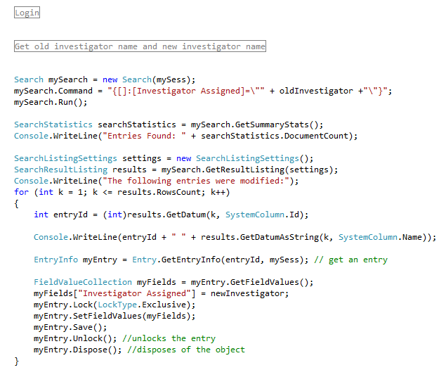
Summary

Slide 40
Write Robust Code
These sample apps work in a perfect environment
Use try-catch statements to handle the unexpected
Notes:
These demo SDK applications work in the perfect environment. In the real-world, you wouldn’t write such simple applications. You’d need to handle the common cases that might come up and cause your application to break. What happens if the logon attempt fails? What happens if the entry doesn’t exist? As you write your application, you should think of the cases that would cause your code to fail, and then handle those cases. A good way to do this is by using try-catch statements that allow you to specify what your code will do to handle exceptions.

Slide 41
Deployment!
Notes:
We just finished talking about using the SDK to create applications that integrate with Laserfiche. Once you’ve created an application, you’re ready to think about how you’re going to get it out to people. That’s where the distribution tools that come with the SDK come in.

Slide 42
Distribution Tools
Run-time installer
Merge modules
Notes:
Our deployment tools won’t deploy the application that you wrote. You’ll still need to put it on the machines where it should go. Distribution tools are a way to ensure that the proper SDK components are present with your application so that it will work wherever it gets deployed. There are two distribution tool options, the run-time installer and merge modules.

Slide 43

Run-Time Installer
Use the installer that comes with the SDK, then copy your application over
Notes:
The run-time installer is the recommended way to ensure that the machine where your SDK application is installed has the necessary SDK components. The run-time installer comes with the SDK, so you just run it on the desired machine and put your application there when it’s done.

Slide 44
Merge Modules
Used with your installer to deliver only the components you need
Notes:
Merge modules are the other distribution option available to you. If you’re writing an installer for your application, you can use the SDK merge modules with your installer to install only the SDK components that your application uses. This is a more advanced option because it requires that you make an installer and it requires that you specify all of the SDK components that you’re using.

Slide 45
Resources!
Notes:
The third part of the SDK is its resources.

Slide 46
Resources
SDK Documentation
  Tutorials
  Sample projects
  Object references
Legacy SDK libraries
Notes:
The SDK documentation is an excellent resource when you’re using the various SDK libraries. The documentation includes sample code and object references to help you build your application. Let’s take a look at some of the documentation that comes with the SDK now.
As you can see, there are several versions of the SDK help documentation. Even if you’re only using the .NET libraries, it’s still a good idea to check out the full SDK documentation because it contains so many tutorials.
In addition to that documentation, the SDK also includes legacy SDK libraries, so you can be sure that as you upgrade versions of the SDK, your application will continue to work.

Slide 47
More Resources
Solution Exchange
Support Site
  Code Library
  Answers Site
Notes:
Now we’ve covered what comes with the SDK, but there are many other resources you can use to get the most out of the SDK. Let’s take a look at the Code Library, Solution Exchange, Support Site, and Answers site to see what they do and why you might use them.

Slide 48
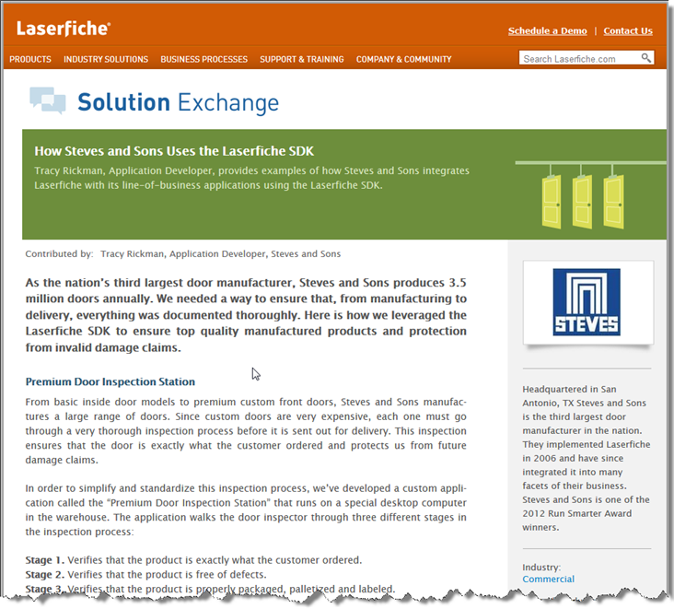
Solution Exchange
Notes:
The solution exchange contains great SDK integrations from Laserfiche VARs and users and is a great place to look for ideas and code you can use.

Slide 49
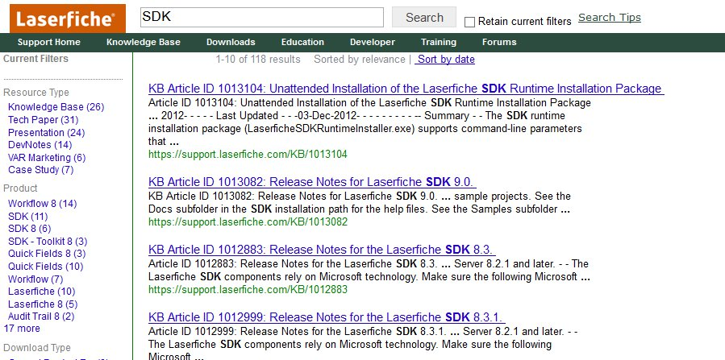
Support Site
Notes:
The Laserfiche Support Site also has a ton of educational resources that you might find useful as you create your SDK applications. These resources include white papers, presentations, knowledge base articles, the answers site, and the Code Library.

Slide 50
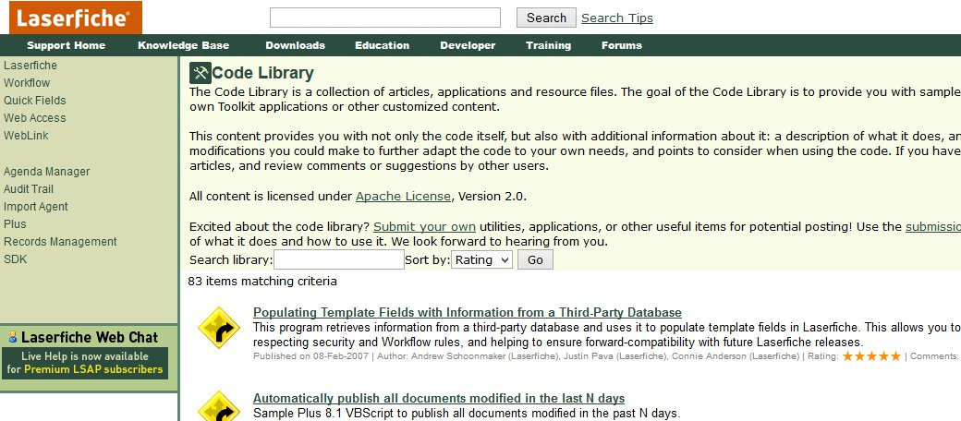
Code Library
Notes:
The Code Library on the Support Site is a great place to find code samples, utilities, and SDK applications written by Laserfiche employees.

Slide 51
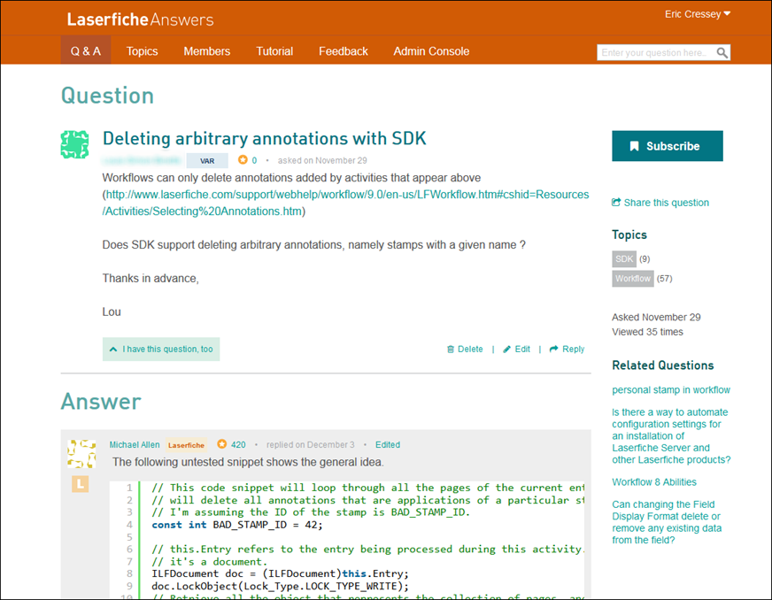
Answers
Notes:
The Answers site is our next-gen forum, where you can go to ask SDK questions and get responses from other users, VARs, and Laserfiche employees. The new answers site makes it easy to share screenshots and code samples and is a great place to find information when you have a specific question.

Slide 52
Further Learning
EDM203: Effective Integration Strategies
CD251: Using the Laserfiche UI in Your Integration
CC302: Capture and Classification with the SDK
EDM351: Advanced Applied SDK

Slide 53
Questions?

Slide 54
Further Learning
EDM203: Effective Integration Strategies
CD251: Using the Laserfiche UI in Your Integration
CC302: Capture and Classification with the SDK
EDM351: Advanced Applied SDK

