Slide 1
Texas A&M Laserfiche Shared Service
Records Management
Hosted by
Texas A&M Information Technology, Laserfiche and SMARTfiles
Presented by Judith H. Lewis, PhD, MS, PMP
Sr. IT Manager, Computing & Information Services Program Manager, Texas A&M IT Laserfiche Shared Service
August 22, 2014

Slide 2
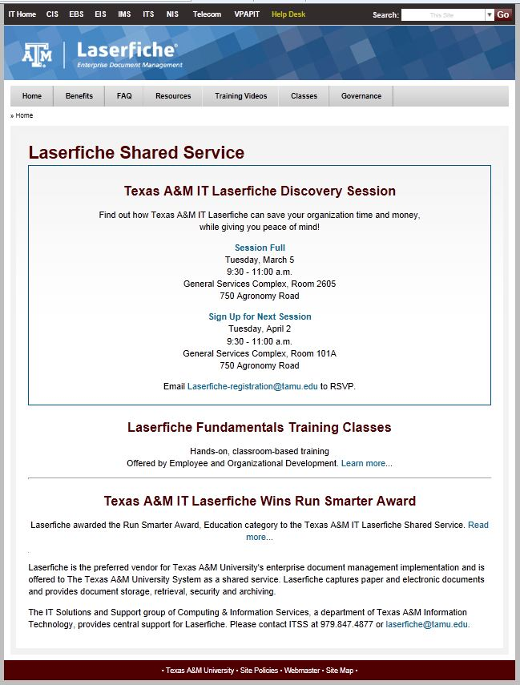
Website for Texas A&M Laserfiche
Judith Lewis

Slide 3
Shared Service Video Library
Judith Lewis

Slide 4
Laserfiche Shared Service Community of Practice and Listserv
Judith Lewis
tamu-laserfiche@listserv.tamu.edu
*The name of the list: TAMU-LASERFICHE
*To Subscribe: email TAMU-LASERFICHE@LISTSERV.TAMU.EDU
Type “Subscribe” in Subject
-or- Provide your preferred email address and sign up today
* To send an email to the list: TAMU-LASERFICHE@LISTSERV.TAMU.EDU
* To unsubscribe from the list: TAMU-LASERFICHE-signoff-request@LISTSERV.TAMU.EDU

Slide 5
Laserfiche EOD Training
Judith Lewis
Laserfiche Fundamentals Training Classes
Hands-on, classroom-based training Offered by Employee and Organizational Development.
Instructor: John Gonzales
For additional information:
Laserfiche.tamu.edu and follow the link
-or-
http://training.tamu.edu/Courses/Detail/1357

Slide 6
Laserfiche Annual Technical Conference
Judith Lewis
Laserfiche Empower 2015, January 13-16, 2015 in Anaheim, CA
Use of Metadata
Use of Workflow
Use of Records Management Edition
Use of API Toolkit
Use of Mobile
Business Process Management
Additional details for Empower 2015:
http://www.laserfiche.com/en-us/Conference
Image courtesy of Laserfiche

Slide 7
Q & A:
Judith Lewis
Thank you for your interest in Laserfiche.
Contact Information:
Texas A&M Information Technology
Computing and Information Services
Laserfiche Enterprise Shared Service
Judith H. Lewis, PhD, MS, PMP
Program Manager
laserfiche@tamu.edu

Slide 8
Texas A&M Laserfiche Shared Service
Records Management
Hosted by
Texas A&M Information Technology, Laserfiche and SMARTfiles
Presented by Judith H. Lewis, PhD, MS, PMP
Sr. IT Manager, Computing & Information Services Program Manager, Texas A&M IT Laserfiche Shared Service
August 22, 2014

Slide 9
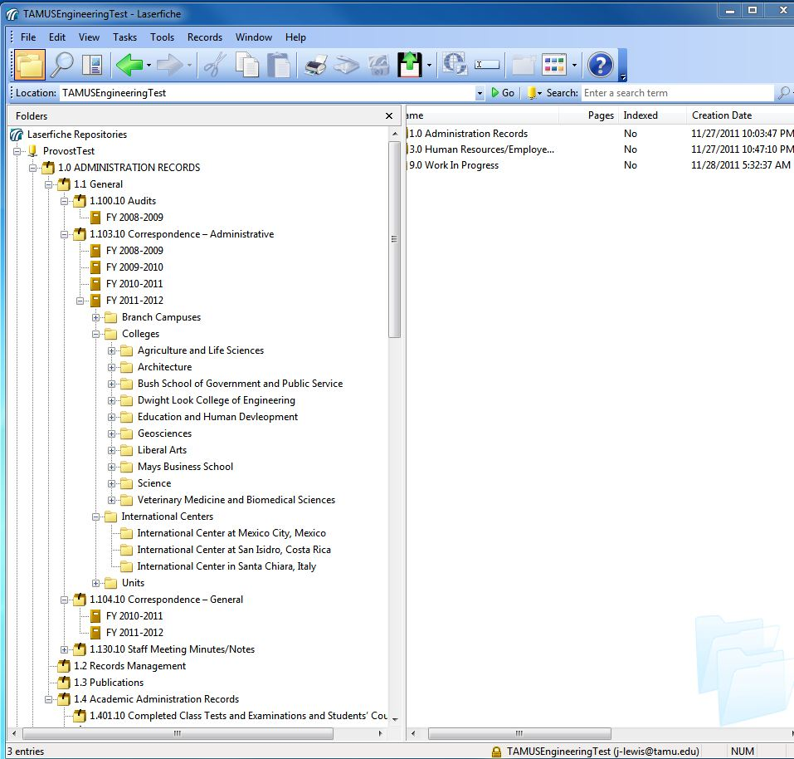
Shared Service Common Folder Structure (Based on System Records Retention Schedule)
Judith Lewis
Retention schedule undergoing change and approval this year
Shared service will integrate changes into the common folder structure
Shared service participants benefit from the shared service work

Slide 10
Best Practices
Judith Lewis
Best Practices:
Determine the approval process for destruction in department
Document departmental procedures for destruction process
Coordinate with Records Management office for documents of record destruction
Determine who in the department can delete from Laserfiche
Exercise process on a regular interval

Slide 11
Introduce Brooks Moore
Judith Lewis
Brooks Moore is managing counsel for the Governance practice area of the Office of General Counsel, and oversees the System's Policy Office. His governance practice focuses on the Public Information Act, Open Meetings Act, System policies and regulations, conflicts of interest/ethics, legislation, state and federal relations, and records management. He also serves as the public information officer for the System Offices and is the System records management officer.
R. Brooks Moore
Managing Counsel, Governance
A&M System Office of General Counsel
(979) 458-6144 (direct)
rbm@tamus.edu

Slide 12
Brooks Moore’s Records Management Topics
Brooks Moore
-Basic purpose of records management
-Records retention requirements applicable ONLY to “state records” (also called “university records” in university’s records management SAP)
-System Regulation 61.99.01 establishes and describes the system’s records management program, coordinated by system records management officer
-System Records Retention Schedule forms basis for lawful destruction of state records listed in the schedule
-Each system member records officer is responsible for that entity’s records management program

Slide 13
An Introduction to Records Management
Eric Gater Records Management Texas A&M University Libraries

Slide 14
Basics of Records Management
The application of management techniques to the creation, use, maintenance, retention, preservation, and destruction of state records for the purpose of improving the efficiency of recordkeeping, ensuring access to public information under Chapter 552, and reducing costs.
The term includes:
The development of records retention schedules
The management of filing and information retrieval systems
The adequate protection of state records that are vital, archival, or confidential
The economical and space-effective storage of inactive records
Control over the creation and distribution of forms, reports, and correspondence
Maintenance of public information in a manner to facilitate access [by all stakeholders]
Preservation and Management of State Records and Other Historical Resources
Government Code, Chapter 441, Subchapter L
Section 441.180.

Slide 15
What exactly is a Record?
Any written, photographic, machine-readable, or other recorded information created or received by or on behalf of a state agency that documents activities in the conduct of state business or use of public resources.
Preservation and Management of State Records and Other Historical Resources
Government Code, Chapter 441, Subchapter L
Section 441.180.

Slide 16
Characteristics of a Record
Authenticity
Record is what it says it is
Reliability
Record is a full and accurate representation of the business transaction
Integrity
Record is complete, unaltered, and protected from unauthorized access and alteration
Usability
Record can be located, retrieved, and used
Notes:
Authenticity – There is evidence that the record is what it purports to be.
Reliability – There is confidence that the record’s content is a full and accurate representation of the business transaction.
Integrity – The record is complete, unaltered, and protected from unauthorized alteration.
Usability – The record can be located, retrieved, presented, and interpreted.
In your packet, there is also a handout, which shows a decision-making tree that lists out a number of questions leading to “Is this a record, or no?” You can feel free to take a look at that at your leisure.
If you ever have doubt or question about if something is a record or not, you should seek out your departmental records coordinator or our office, and we will be happy to work with you.

Slide 17
Life Cycle of a Record
Notes:
So lets talk a little bit about what we refer to as the lifecycle of a record.
There are four main phases of life through which a records moves:
Creation (e.g. through a new business transaction)
Active use
Semi-active use or dormancy
Inactivity and Destruction
This is a little bit of a “straw man” question, but when do you suppose you should start thinking about managing these records?

Slide 18
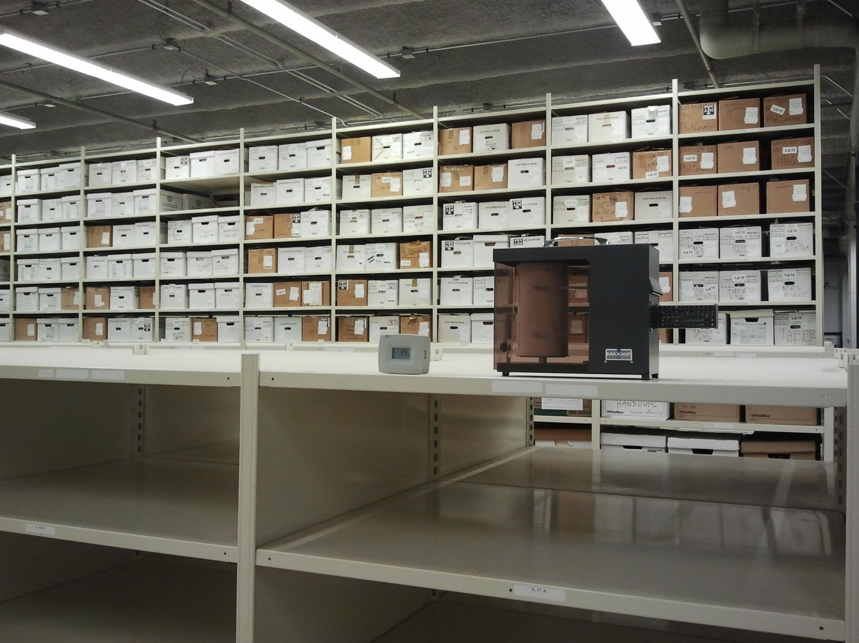
Records Management at A&M
Notes:
It is a secure, temperature-controlled facility. Access is limited to only a handful of people, so if you need to get to your files you must make an appointment.
We are generally there from 8-5 every day, except for when we are at meetings, teaching classes, etc.

Slide 19
Records Management at A&M
Surveying records within a department
Provide secure records storage, destruction, and information retrieval
Authorize the destruction of eligible state records
Maintain Records Retention Schedule
Records Retention Research
Offer Instructional Classes

Slide 20
Records Retention Schedule

Slide 21
Storage & Destruction Forms

Slide 22
http://library.tamu.edu/records
Notes:
Click through to display RRS
Also pull up forms

Slide 23
Records Storage
Determine what records you have
Pack in 1.2 cu. ft. boxes
Fill out the Records Storage Form
Call to make a pickup appointment
Label with a unique box number (e.g. ENG-2012-01)
Notes:
OK, so now let’s talk about the primary functions of what we do: Storage and Destruction.
The first step in either case is to survey your records and determine what it is you have, and whether or not it is past retention.
Accurate dates

Slide 24
Records Destruction
3 varieties of destruction:
Records Center Destruction
Records
Convenience Copies
Departmental Destruction
Post-Retention Destruction Authorization
Notes:
There are three varieties of destruction that we accommodate:
Records Center Destruction refers to the boxes of records that a department has prepared for us to pick up and destroy. Similar to the procedure for Records Storage, you would survey your files, box them (not necessarily in new officemax boxes, but they must be in good shape or else we will not take them, and them must be under 40 lbs or we won’t take them), fill out the destruction form, and arrange a pick up. Due to the sheer number of boxes that take in every week, we are not able to destroy all of these boxes in-house. Currently, we work with the Harris County Department of Education to outsource this shredding. However, some departments prefer that particularly sensitive information be handled personally, therefore we will shred a department’s boxes in-house if requested.
Departmental Destruction refers to when a department requests to shred their own records in-house. In this case, you must still fill out the form, send it to me for my review and signature, and then shred. After the destruction of the records, you must then sign off as the Destruction Witness and send the final, completed form back to me for my records.
Every few months, I will run a query in our database telling me what boxes are past their retention and eligible for destruction. At this time, I will produce a report for your department of what these boxes are, and send you a Post-Retention Destruction Authorization form, for your review and signature. At this time, you also have the opportunity to apply a hold to the boxes (for instance, if you anticipate needing them for a legal case). We will never destroy boxes without your approval and signature.

Slide 25
Other Resources
Principles of Records Management (through Employee &Organizational Development)
Fundamentals of Managing Departmental Records (TrainTraq #2111143)

Slide 26
Texas A&M University Records Management
Eric Gater
Records Management
330 Agronomy Rd., Ste. 160
(979) 458-1470
RMDesk@library.tamu.edu
http://library.tamu.edu/records

Slide 27
Q & A:
Judith Lewis
Thank you for your interest in Laserfiche.
Contact Information:
Texas A&M Information Technology
Computing and Information Services
Laserfiche Enterprise Shared Service
Judith H. Lewis, PhD, MS, PMP
Program Manager
laserfiche@tamu.edu

