Slide 1
Building Business Processes in Laserfiche Forms
Presented by Judith H. Lewis, PhD, PMP
Sr. IT Manager, Computing & Information Services Project Manager, Texas A&M IT Laserfiche Shared Service
February 5, 2014

Slide 2
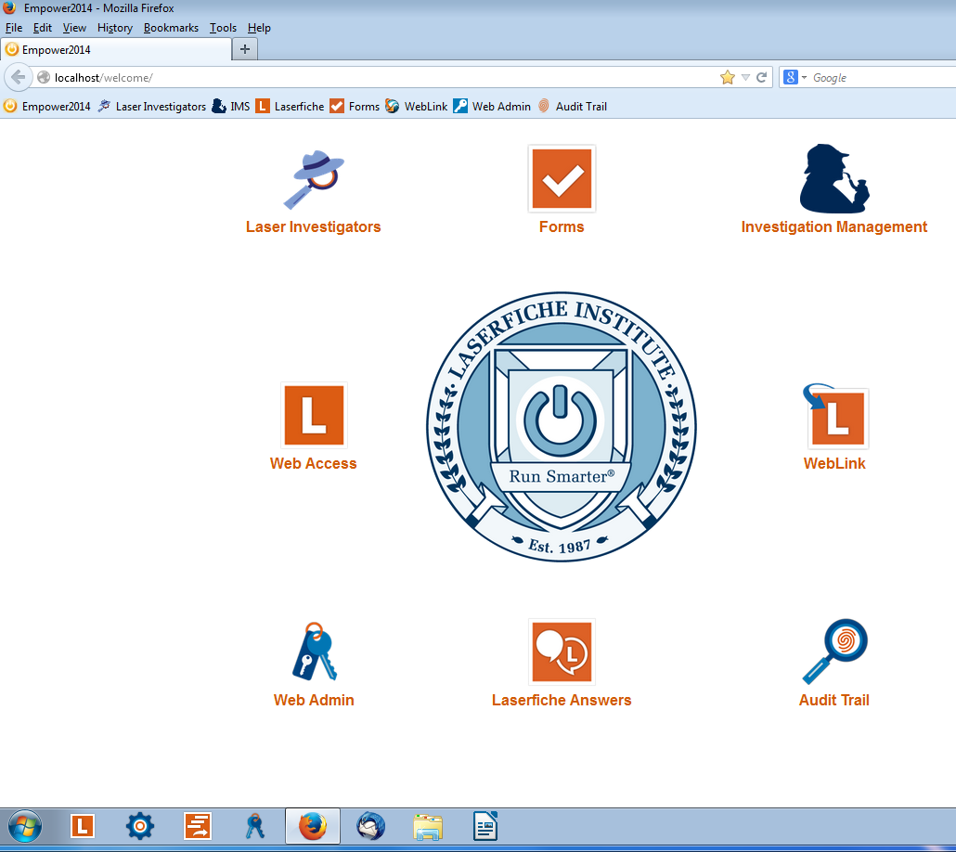
Select ‘Forms’ on the beginning screen
Judith Lewis

Slide 3
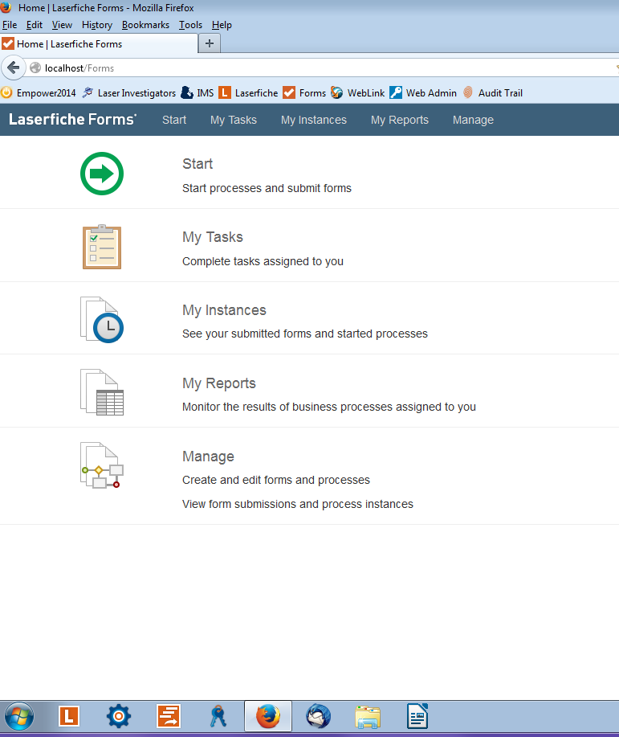
Select ‘Manage’ to begin creating a business process

Slide 4
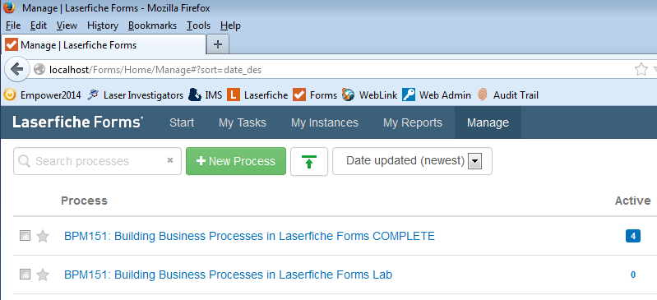
Select ‘New Process’
Judith Lewis
BPM151 Business Process courtesy of Laserfiche (Empower2014 Conference materials).
Notes:
Opportunity to leverage experience and skill sets
Access to wider pool of resources
Conventions and Best Practices – Agile: “Do it incrementally.”
Steering Committee
TAMU User Community of Practice
Professional Support and Training
Educational outreach (training, website, user groups, etc.)
System-wide collaboration
Document sharing
Facilitated workflow
Leveraging legacy systems
Shared experience
Contracts management
Promotion and Tenure process
Route within a department
Within a college
To the President
Board of Regents
And back

Slide 5
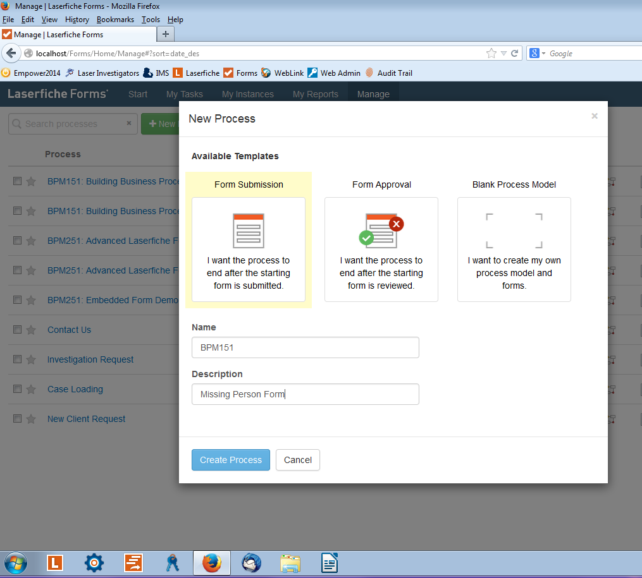
Judith Lewis
Select appropriate template
Insert ‘Name’ and ‘Description’
Select ‘Create Process’

Slide 6
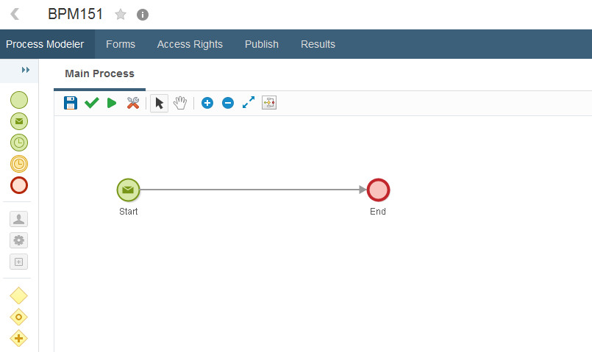
The templates ‘Form Submission’ and ‘Form Approval’ will automatically place a ‘Start’ and an ‘End’
Judith Lewis

Slide 7
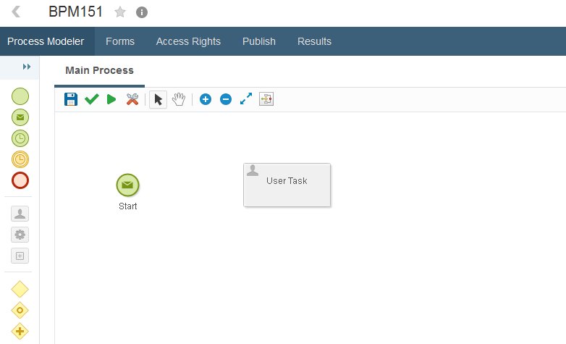
To begin inserting a task or gateway, drag and drop the desired item onto the blank space
Judith Lewis

Slide 8
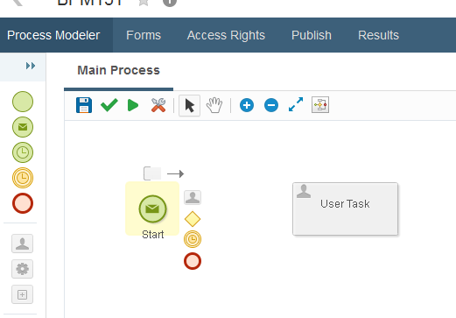
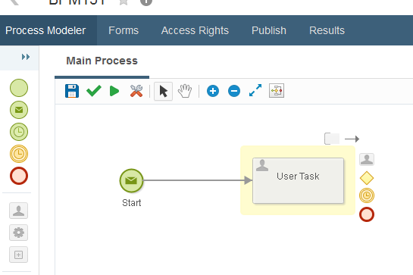
To create a pathway, click originating icon and drag it to the next location

Slide 9
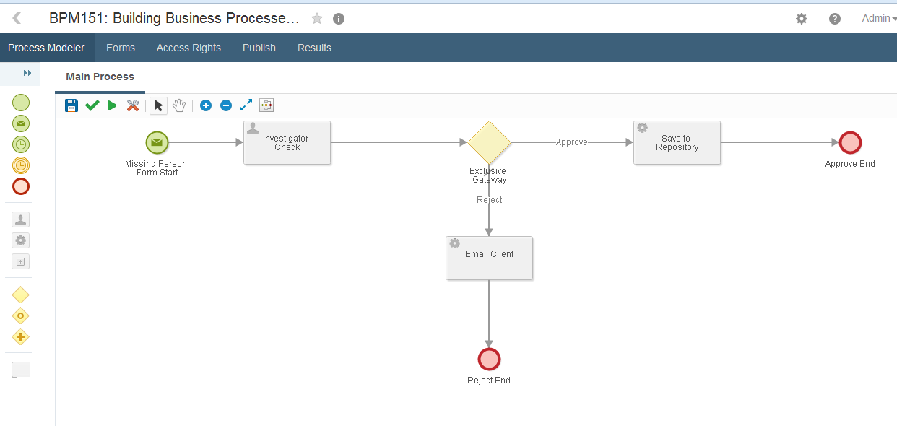
Continue placing tasks and gateways until the process is complete
Judith Lewis

Slide 10
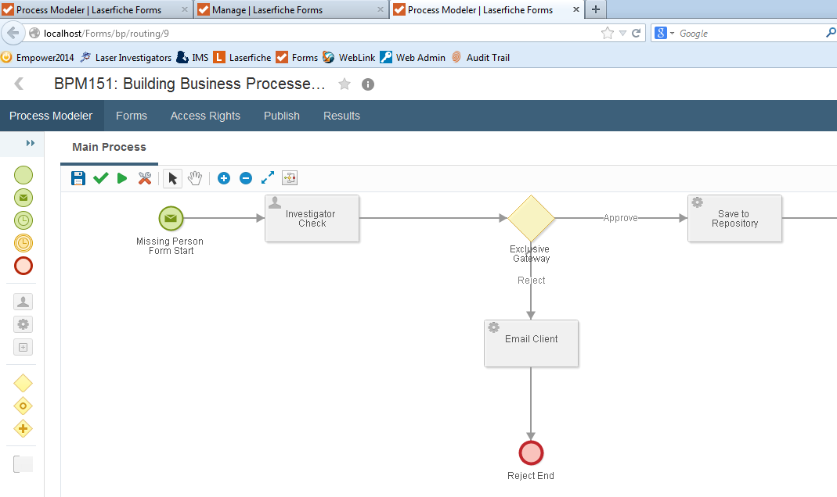
How to Create a Form
Judith Lewis
Once the process is complete, select ‘Forms’ to begin creating a form.

Slide 11
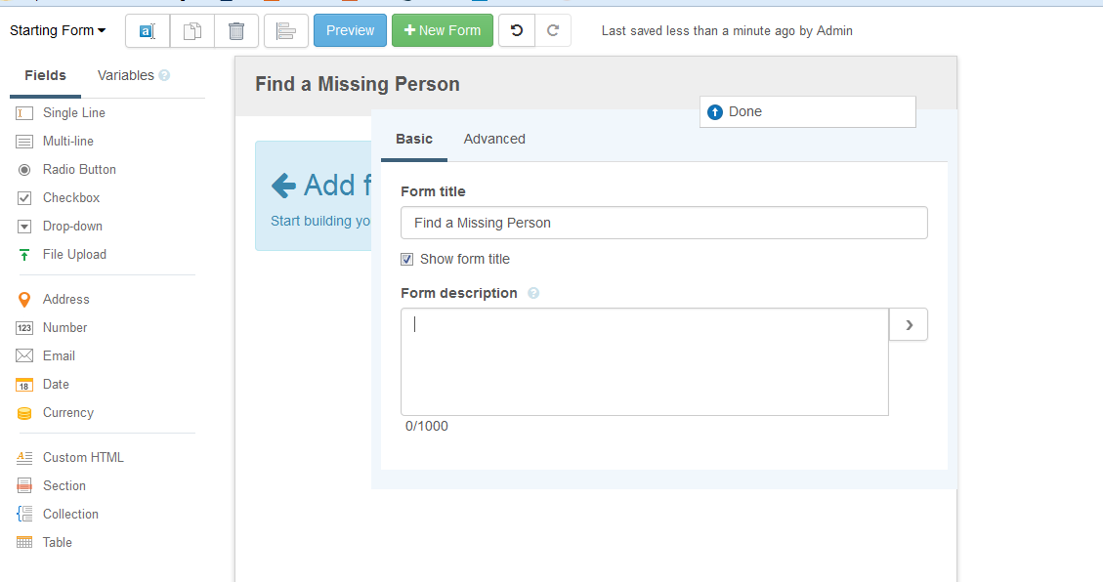
Select the header to edit it. Insert ‘Form title’ and ‘Form description,’ if necessary
Judith Lewis

Slide 12
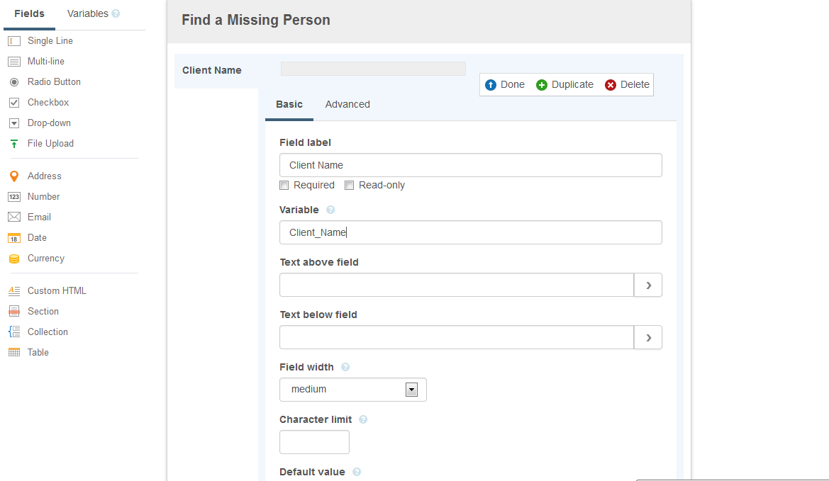
To insert fields, drag and drop them onto the form, and insert desired information
Judith Lewis

Slide 13
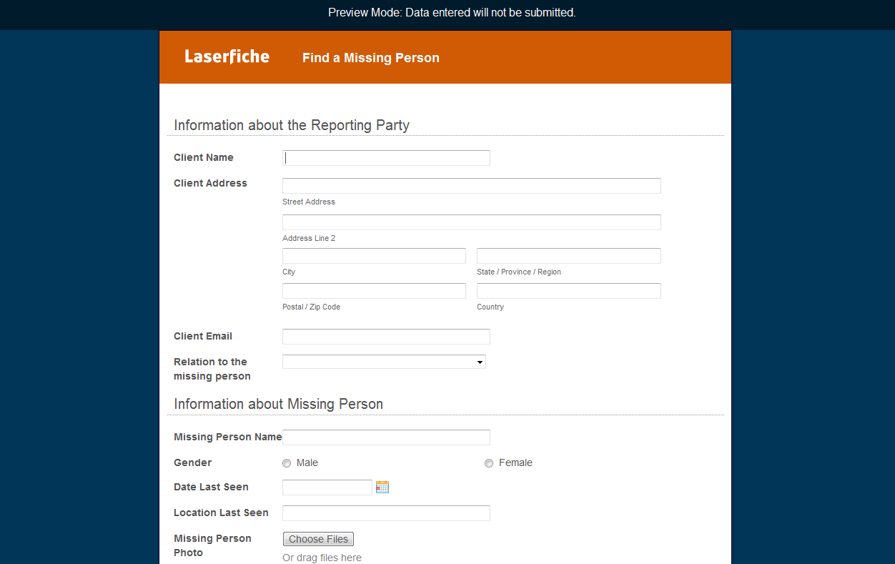
Completed form
Judith Lewis

Slide 14
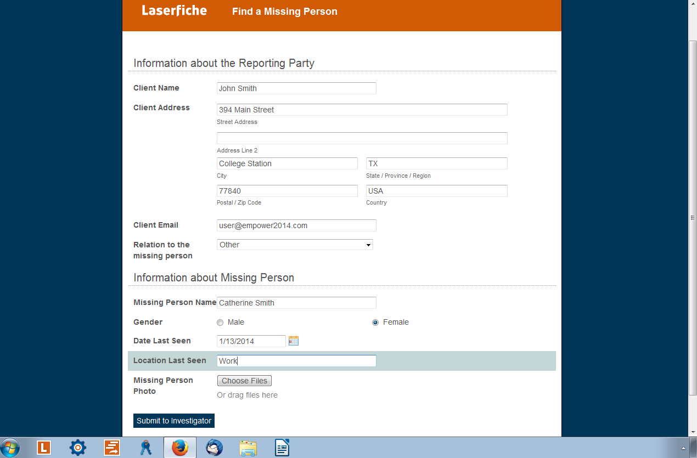
Missing Person Form Process
Judith Lewis
The process is triggered when a Missing Person form is submitted.

Slide 15
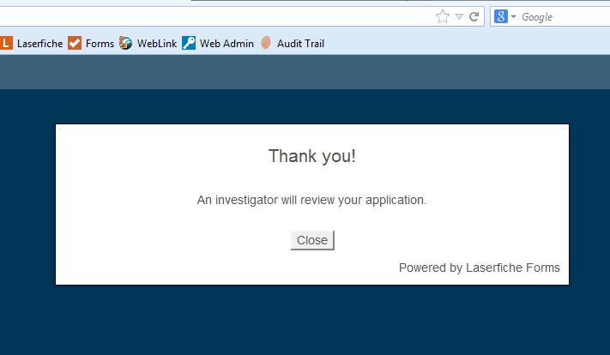
Once the client submits a Missing Person form, a thank you confirmation screen is shown
Judith Lewis

Slide 16
When a Missing Person form is submitted, an admin will be notified via e-mail
Judith Lewis

Slide 17
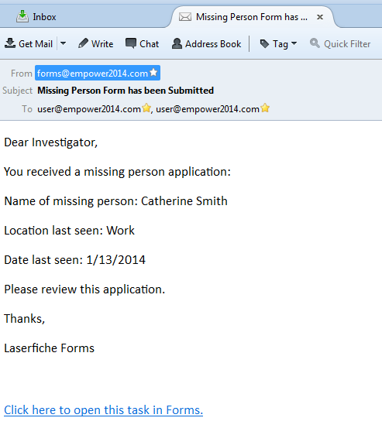
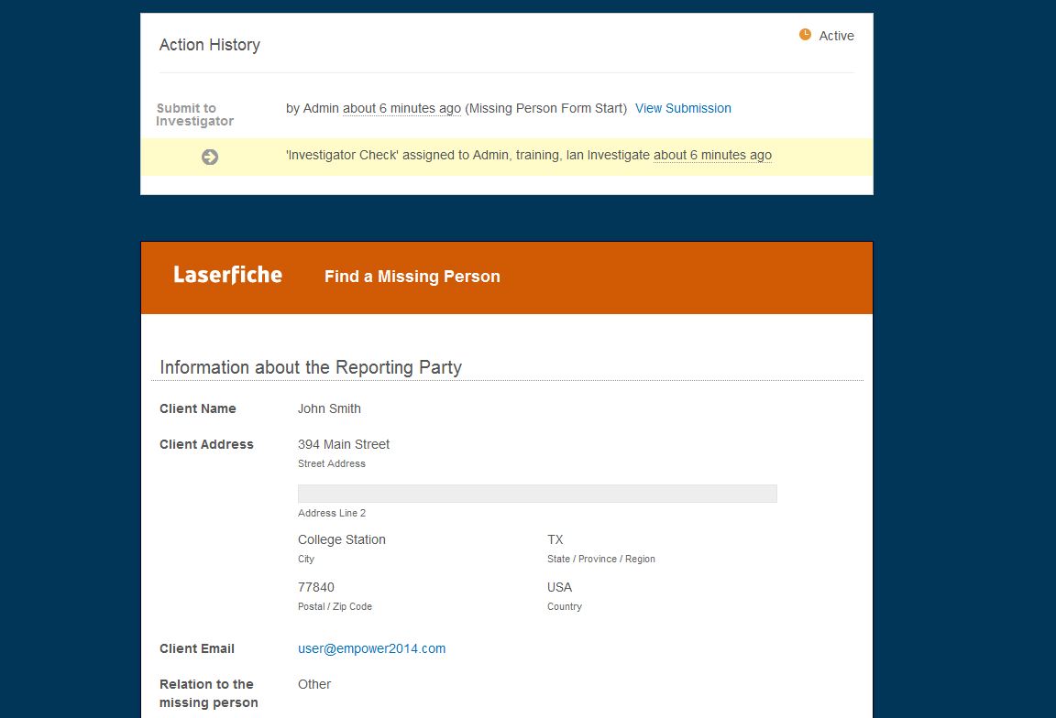
In the e-mail, a link will be provided to the submission form. The submission will not be able to be changed
Judith Lewis

Slide 18
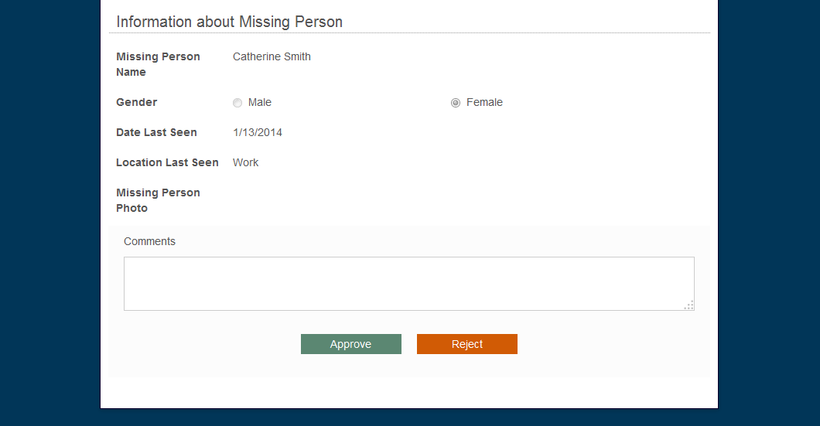
At the bottom of the submission, the form can be approved or denied
Judith Lewis

Slide 19
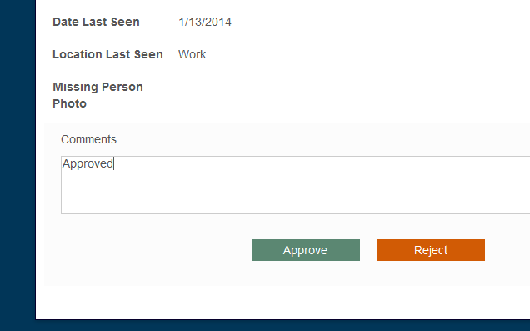
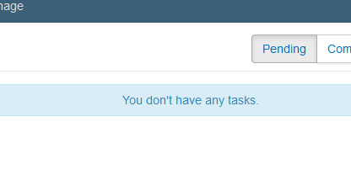
Once approved, the task will no longer be pending
Judith Lewis

Slide 20
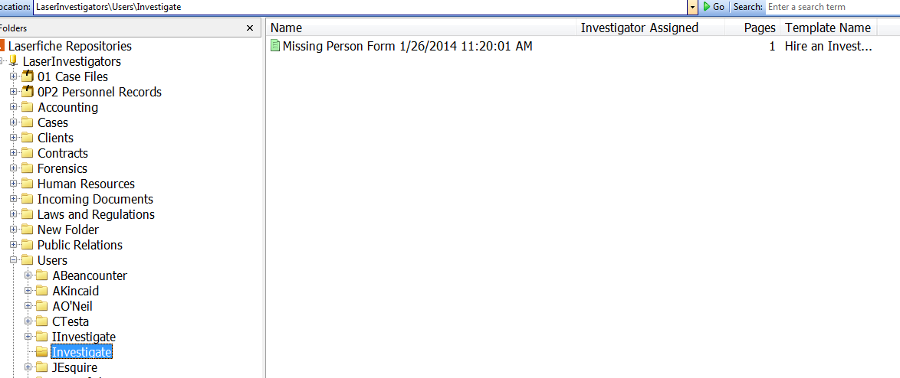
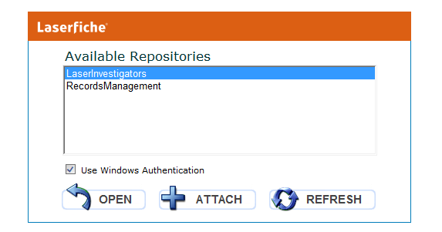
When the task is approved, it will be stored in the appropriate repository
Judith Lewis

Slide 21
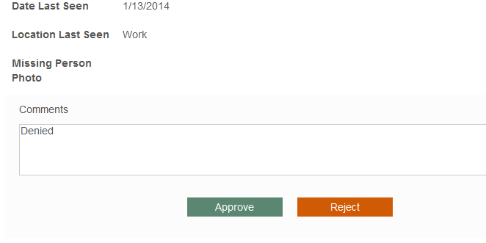
If the submission is denied, an e-mail is sent stating so
Judith Lewis

Slide 22
Q & A:
Judith Lewis
Thank you for your interest in Laserfiche.
Contact Information:
Texas A&M Information Technology
Computing and Information Services
Laserfiche Enterprise Shared Service
Judith H. Lewis, PhD, PMP
Project Manager
laserfiche@tamu.edu

