Slide 1
WELCOME!
Texas A&M Laserfiche Shared Service
User Workshop
Hosted by
Texas A&M Information Technology, Laserfiche and SMARTfiles
Presented by Judith H. Lewis, PhD, MS, PMP
Sr. IT Manager, Computing & Information Services Program Manager, Texas A&M IT Laserfiche Shared Service
August 18, 2014

Slide 2
Texas A&M Laserfiche second annual Shared Service Training Workshop
Judith Lewis
MONDAY AUGUST 18 | 10:00 A.M. – 3:00 P.M.
AGENDA
10:00 AM – 10:15 AM Meet your community and coffee
10:15 AM – 10:45 AM Welcome and Shared Service Update
10:45 AM – 11:15 AM Ways to use Metadata
11:15 AM – 11:45 AM Workflow in Action: What to Automate, How to Start
11:45 AM – 12:00 PM Business Process Redesign: Overview and Prep for the afternoon session
12:00 PM – 1:00 PM LUNCH
1:00 PM – 2:00 PM Business Process Redesign
2:00 PM – 2:15 PM BREAK
2:15 PM – 3:00 PM Help: Laserfiche Answers, CPP, Solution Exchange,
Help Files
DOOR PRIZES

Slide 3
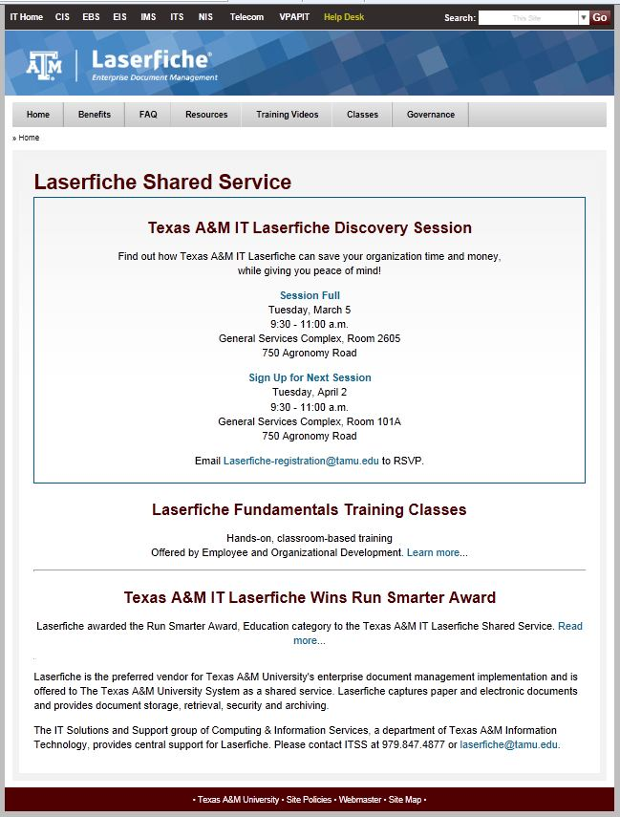
Website for Texas A&M Laserfiche
Judith Lewis

Slide 4
Shared Service Video Library
Judith Lewis

Slide 5
Laserfiche Shared Service Community of Practice and Listserv
Judith Lewis
tamu-laserfiche@listserv.tamu.edu
*The name of the list: TAMU-LASERFICHE
*To Subscribe: email TAMU-LASERFICHE@LISTSERV.TAMU.EDU
Type “Subscribe” in Subject
-or- Provide your preferred email address and sign up today
* To send an email to the list: TAMU-LASERFICHE@LISTSERV.TAMU.EDU
* To unsubscribe from the list: TAMU-LASERFICHE-signoff-request@LISTSERV.TAMU.EDU

Slide 6
Laserfiche EOD Training
Judith Lewis
Laserfiche Fundamentals Training Classes
Hands-on, classroom-based training Offered by Employee and Organizational Development.
Instructor: John Gonzales
For additional information:
Laserfiche.tamu.edu and follow the link
-or-
http://training.tamu.edu/Courses/Detail/1357

Slide 7
Laserfiche Annual Technical Conference
Judith Lewis
Laserfiche Empower 2015, January 13-16, 2015 in Anaheim, CA
Use of Metadata
Use of Workflow
Use of Records Management Edition
Use of API Toolkit
Use of Mobile
Business Process Management
Additional details for Empower 2015:
http://www.laserfiche.com/en-us/Conference
Image courtesy of Laserfiche

Slide 8
Texas A&M Laserfiche User Workshop: What’s new…
Judith Lewis
Image courtesy of Laserfiche
Available from the Laserfiche Shared Service on repository basis
Requires Department Head approval
Recommend departments establish security policies and procedures for mobile use

Slide 9
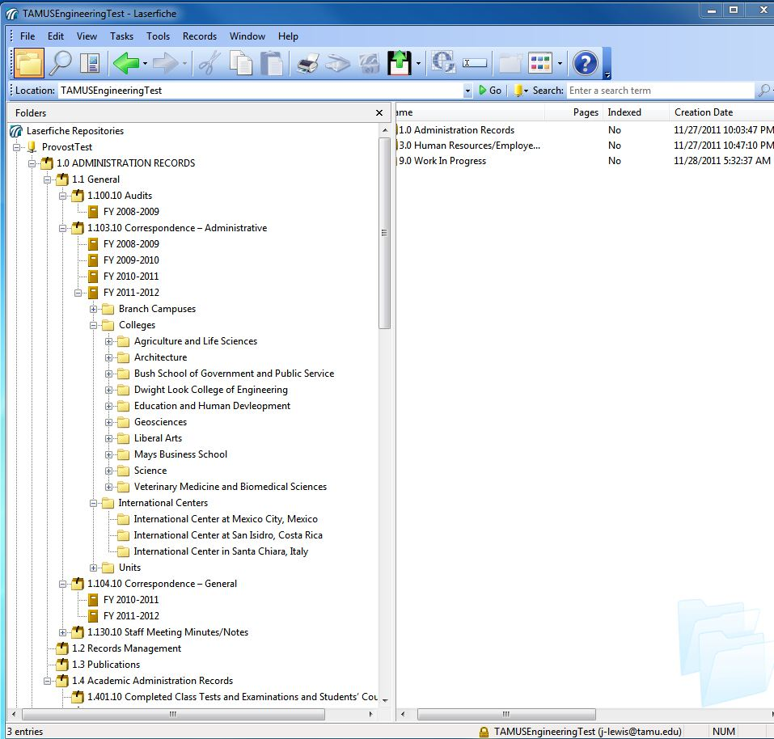
Shared Service Common Folder Structure (Based on System Records Retention Schedule)
Judith Lewis
Retention schedule undergoing change and approval this year
Shared service will integrate changes into the common folder structure
You benefit from the shared service work

Slide 10
Texas A&M Laserfiche User Workshop: What’s new…
Judith Lewis
Image courtesy of Laserfiche
Undergoing pre-release, enterprise enhancements during FY14
Now available for all repositories

Slide 11
Ways to Use Metadata
Image courtesy of Laserfiche

Slide 12
Workflow in Action: What to automate
Presented by:
Melissa Henley and Zachary Buck
Image courtesy of Laserfiche

Slide 13
Process Redesign: Overview and Setup
Image courtesy of Laserfiche
Overview and Prep for afternoon session.
Presented by:
Zachary Buck

Slide 14
Lunch
Lunch served from 12 noon until 1 p.m.
In HSC Room HPEB-LL 11A

Slide 15
Business Process Redesign
Image courtesy of Laserfiche
Presented by:
Zachary Buck

Slide 16
Break
Please return in 15 minutes.
Thank you!

Slide 17
Laserfiche Help
Laserfiche Answers, CPP, Exchange
Image courtesy of Laserfiche

Slide 18
Wrap up and Door prizes
Judith Lewis
Questions? Ask our Laserfiche Experts.
Door Prizes
Thank you!

Slide 19
Q & A:
Judith Lewis
Thank you for your interest in Laserfiche.
Contact Information:
Texas A&M Information Technology
Computing and Information Services
Laserfiche Enterprise Shared Service
Judith H. Lewis, PhD, MS, PMP
Program Manager
laserfiche@tamu.edu

