Slide 1
Where Do I Start? What Do I Automate?
Melissa Henley
Director of Marketing Communications

Slide 2
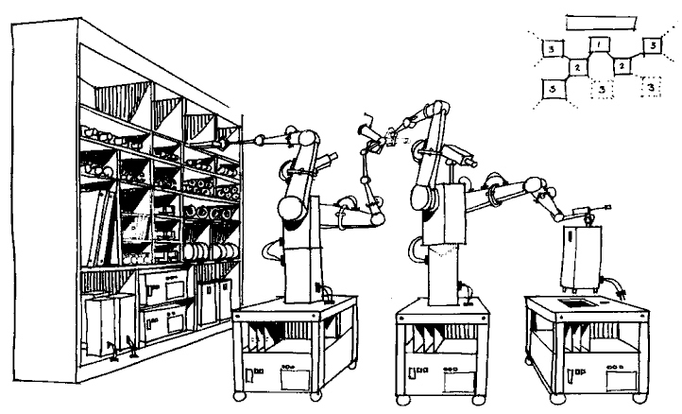
Is This How You Think of Automation?

Slide 3
Or This?

Slide 4
4 Steps to Getting Started
Step 1: Establish Ownership
Step 2: Secure Buy-In
Step 3: Gather Requirements
Step 4: Map the Process

Slide 5
What Could You Change?
Eliminating unnecessary steps from a process
Changing inefficient procedures
Redesigning forms
Improving communication between departments
Introducing process efficiencies through small process changes
Notes:
Quick wins provide project momentum by driving early value and improved ROI. They also provide confidence to the broader organization that the project is viable and should be supported. On a large project, they show immediate value by GETTING SOMETHING DONE.
When you’re implementing a project, potential quick wins include:
Eliminating unnecessary steps from a process
Changing inefficient procedures
Redesigning forms
Improving communication between departments
Introducing process efficiencies through small process changes
Start using available features in software that have not been implemented yet
Providing training on best practices

Slide 6
Our Example: HR
HR employees are storing all documents as paper or scanning to shared drives as PDFs.
All employee information is already stored in a database.
Retention policies are not being followed as closely as they should be.
Hard copies may be requested by employees or managers whenever necessary.
Notes:
Background
-HR is decentralized at TAMU. Every department, college, campus, etc. has their own HR department.
-Every HR department is facing increasing pressure to adhere to the university’s records retention policies for every document type.
-Right now a majority of the HR departments are storing everything as paper or maybe just scanning to shared drives as PDF.
-Very few departments even regard the retention policy. If they do, then they are just looking at which document type has the longest retention period, and keeping all document types for that period of time.
IE: We keep Resumes for 3 years, Performance Review for 5 years, and W4s for 7 years. Instead of destroying Resumes after 3 years, they wait until 7 years have passed and destroy everything.
-Attached is a document that outlines the different records categories that HR has to have.
-There are a lot of departments looking at HR right now and this would be an excellent way to showcase why LF is different than scanning to a network folder.
Make sure to point out: this process can plug into any retention schedule/retention rule (just change the token)

Slide 7
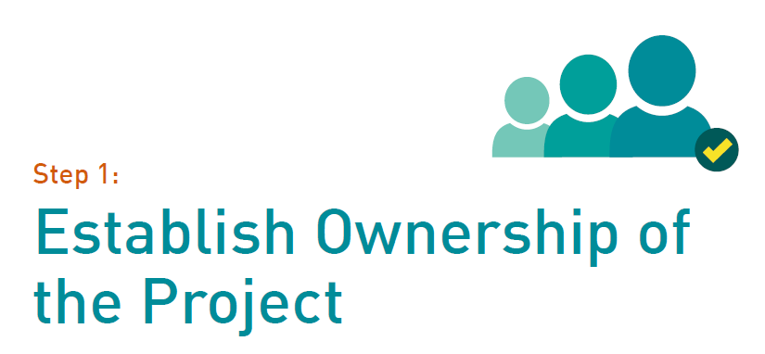

Slide 8
Project Owner vs. Project Champion
Project Owner: handles daily operations
Project Champion: shares the vision of automation with stakeholders and gathers support
Notes:
Both project leaders should be able to effectively communicate with all involved departments, including IT. They should understand the needs of end users who will be using the new system daily, express the value of automation to different departments, employees and stakeholders, and identify early advocates of automation and enlist their help in gaining support.
RUN SMARTER EXAMPLE – JOANNA VS ME

Slide 9
Our Example: HR
Who might be the Project Owner?
Who might be the Project Champion?
Notes:
Maybe skip this …

Slide 10
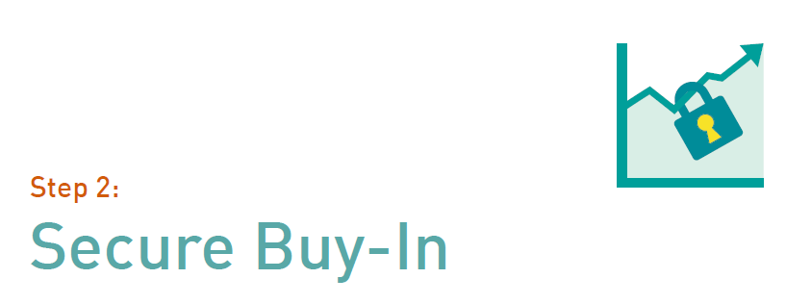

Slide 11
People Need a Reason to Change
Notes:
The project champion should obtain support from all involved departments to realize the full time- and cost-savings of automation. If you automate a process and people work around it, would you say your project was a success?
The project owner should seek out supporters in other departments who are frustrated by the manual process, such as
department heads who must constantly walk forms from one desk to another. These people will be most likely to advocate for change and spread support across other units in the organization.

Slide 12
Our Example: HR
What ways could our Project Champion get buy-in for this automation initiative?
Notes:
Talk to managers about how it will be easier to get information
Talk to HR techs about how retention will be automatically enforced and there will be no data entry
Talk to senior management about retention/governance & compliance

Slide 13
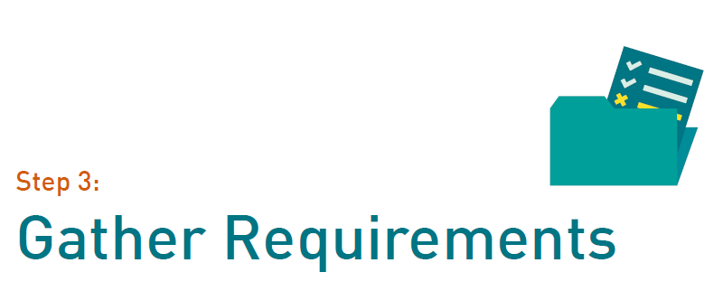

Slide 14
Analysis
What is the desired outcome?
What is the beginning? The end?
Who does what when, where and why?
What information needs to be passed on?
How will I know if my project is a success?
Notes:
(You will probably spend the most time on this step)
Once department leaders are on board, the project owner should begin obtaining information about the process from end users, stakeholders and any other involved parties. In particular, identifying pain points helps the project owner separate the essential steps of the process from the non-essential ones.
Draw out the requirements here because when you diagram it later – easier. When you have the buy in, you define what makes the project a success.

Slide 15
Back to Our Example …
What is the desired outcome?
HR documents scanned and archived in proper records series
Automatic folder creation with metadata automatically applied from HR database
Retention schedules automatically applied
Viewing shortcuts for authorized departmental managers

Slide 16
Start and End Points
What is the beginning? The end?
The Beginning – when document is received from employee
The End – when scanned document is destroyed in accordance to retention policy

Slide 17
Activities Performed
Who does what, when, where and why?
Documents are received by HR staff
Filed in file cabinet or scanned onto network drive
Manually indexed
Record entry added to master entry log
Destroyed when longest retention period ends
Notes:
Good to be specific here – easy to miss parts or steps that will throw you for a loop later. Be specific of where things are coming from or where they are going. Whole class on just this at the conference! Making coffee
Direct translation into the software – more detailed you are here, easier things will be later!

Slide 18
Knowledge Transfer
What information needs to be exchanged?
Employee name
Date of Birth
Hire Date
SSN
Department
Supervisor/Manager

Slide 19
Begin With the End in Mind
How Will I Know if My Project is a Success?
Budget
Timing
Scope
Quality
Customer satisfaction

Slide 21
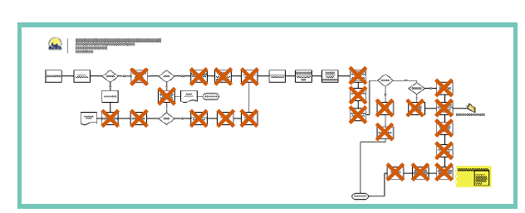
Why Map the Process?
Notes:
During this phase, the project owner should work with IT to diagram processes. The project owner should also collaborate with
end users to make sure essential components and departmental requirements are not lost.
Eliminate duplication of work
Agree on steps that can be automated – remove unnecessary manual steps
Grab metadata at the right point to eliminate manual keying

Slide 22
Our Example: Initial Process
HR receives document
HR scans or files document
HR adds to master records log
HR manually indexes document
HR destroys according to retention schedule

Slide 23
Our Example: Proposed Process
HR receives document
HR scans document
HR enters document type and name
HR destroys according to retention schedule

Slide 24
Solution Configuration
Quick Fields: scan/capture on steroids
Workflow: powerful automation
Forms: data collection, basic routing and approval
Records Management Edition: automate retention
Notes:
Quick Fields:
Scan/Capture software on steroids
Process and split batch jobs
Read from scanned images – Barcode, Zone OCR
Identify documents, forms
Agent
Workflow:
Automate documents inside repository
Move, create, delete, file, shortcut
Send email, escalation, deadlines
Integrate with external data sources
Scripting
Forms:
Collect input from users
Simple automation – routing and approvals
Trigger Workflows
RME:
Automate the tracking of documents towards destruction
Automate retention policies

Slide 25
Beware …
Notes:
Bad physical process = bad automated process
Scope creep
Not involving users
Not automating using modular methods

Slide 26
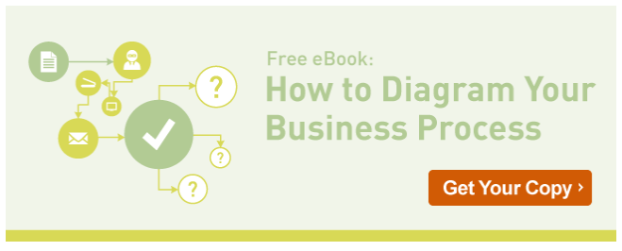
And If You’d Like to Learn More …
Notes:
http://ecm.laserfiche.com/business-process-diagram-ebook

Slide 27
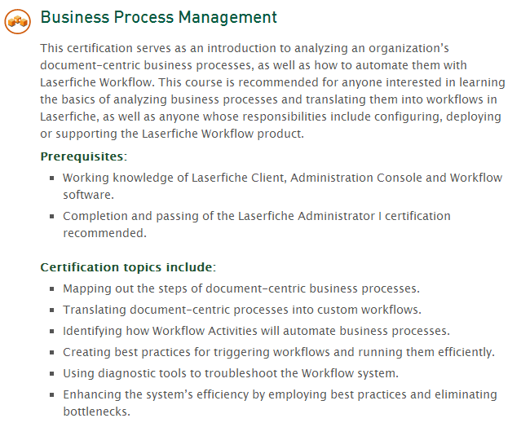
Online Certification
Notes:
What is Business Process Automation: http://www.laserfiche.com/ECMBlog/Article/what-is-business-process-automation-bpa
5 Bad Pieces of Advice: http://www.laserfiche.com/ECMBlog/Article/5-bad-pieces-of-advice-about-business-process-automation
How to Diagram Your Business Process: http://www.laserfiche.com/solutionexchange/article/how-to-diagram-your-business-process

Slide 28
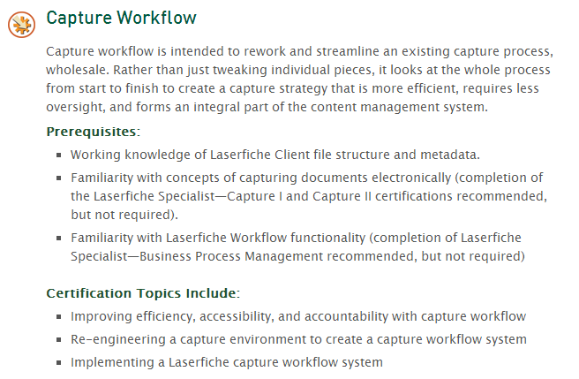
Online Certification
Notes:
What is Business Process Automation: http://www.laserfiche.com/ECMBlog/Article/what-is-business-process-automation-bpa
5 Bad Pieces of Advice: http://www.laserfiche.com/ECMBlog/Article/5-bad-pieces-of-advice-about-business-process-automation
How to Diagram Your Business Process: http://www.laserfiche.com/solutionexchange/article/how-to-diagram-your-business-process

Slide 29
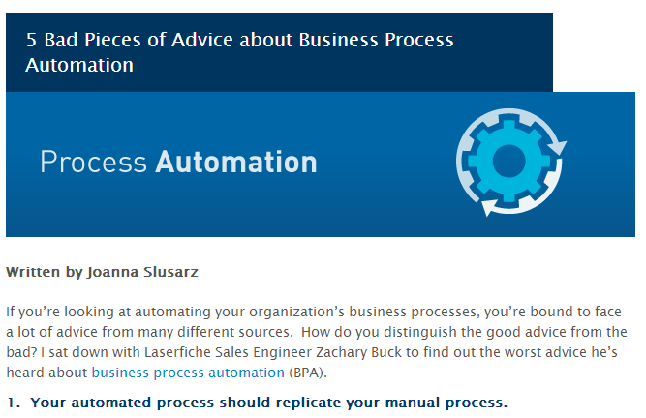
ECM Blog
“What is Business Process Automation?”
“5 Bad Pieces of Advice About Business Process Automation”
And more!
Notes:
What is Business Process Automation: http://www.laserfiche.com/ECMBlog/Article/what-is-business-process-automation-bpa
5 Bad Pieces of Advice: http://www.laserfiche.com/ECMBlog/Article/5-bad-pieces-of-advice-about-business-process-automation
How to Diagram Your Business Process: http://www.laserfiche.com/solutionexchange/article/how-to-diagram-your-business-process

Slide 30
Questions?
Melissa Henley melissa.henley@laserfiche.com (562) 988-1688 x230

