Slide 1

Help!
Melissa Henley
Director of Marketing Communications
Pieter Nauta
Manager of Training

Slide 2

What You’ll Learn Today
What resources are available from Laserfiche
What certifications are right for you
What you’ll get out of Empower 2014

Slide 3

Teach a Man to Fiche…
Notes:
“Give a man a fish and he will eat for a day, teach a man to fish and he will eat for a lifetime”
How does this relate to this class? When you ask for help and are given an answer, you have learned how to solve a single problem. But if you know how to use the resources available to you, you will be able to solve anything!
But before you can fish, you need the right bait (next slide)

Slide 4
Know What You Are Looking For
What are you trying to do?
Where are you?
When do you need help?
Notes:
For us, “bait” means context. You need to know what you are looking for. Some things to note are:
What are you trying to do? What do you want to configure?
Where are you? Where are you in the product, what product are you in?
When do you need help? Is it when you’re configuring something, or is it when you get a certain error message?
Once you define your problem and know specifics, then you’re ready to go!

Slide 5

The Laserfiche Support Site

Slide 6
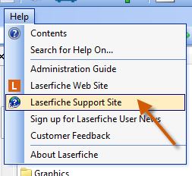
Sign Up for the Support Site
Laserfiche 8.3 and higher will automatically populate your serial number on the Support Site Registration page the first time you click “Laserfiche Support Site” from the Help drop-down menu
Notes:
If you are running Laserfiche 8.3 or earlier, get your serial number (about LF box)
Laserfiche 8.3 and higher will automatically populate your serial number (on the Support Site Registration page) the first time you click “Laserfiche Support Site” from the Help drop-down menu.

Slide 7
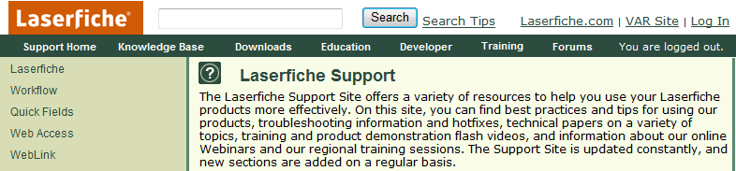
Get Logged In!
Notes:
Make sure you are logged in! The Support Site looks the same whether you are logged in or logged out.

Slide 8
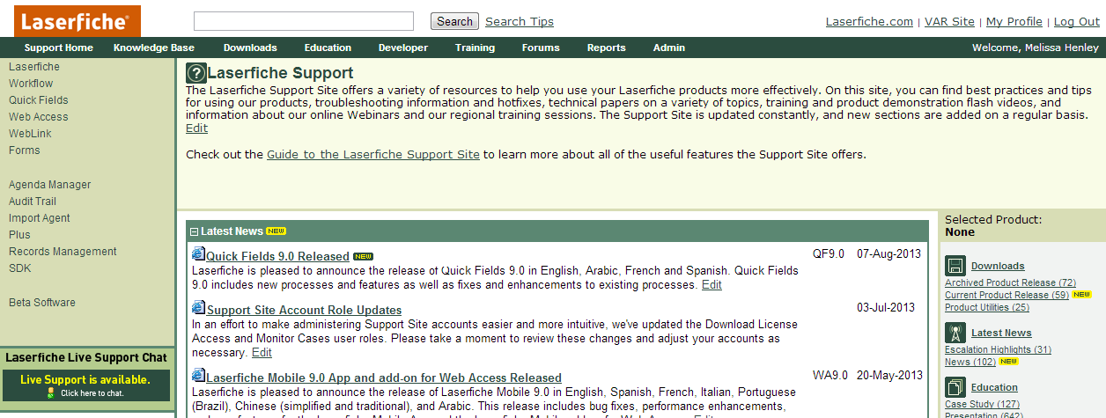
Notes:
The Laserfiche Support site offers a wide variety of information, such as best practices, tips, troubleshooting, hotfixes, technical papers, and tutorial videos. You can also find information about our online Webinars and regional trainings.
The Support Site is active! This is where the we post new material and have community discussions (forums).
See also, the Product Roadmap link located at the bottom of the “Selected Product” pane (right-hand side)

Slide 9
Support Site Resources
Technical papers: Detailed information
Knowledge Base (KB) articles: Product specifications, error handling
Videos: Demonstrations and tutorials
Forums: Ask questions, get answers
Trainings: Advance your knowledge
Notes:
In the Knowledge Base tab, the Featured Articles section shows a few very important KBs. Open the Current Release Versions KB to see the most recent versions of the products.
In this KB, there are links for each Laserfiche product. Typically, these are links to the List of Features and the Release Notes KBs. These KBs give detailed information about a specific version of the product.
1. Release Notes: Summary, System Requirements, and Compatibility information
2. List of Features: Details about the whole product, what you can do with it, how you interact with it, and what solution it contributes to the Laserfiche suite.
Forums – post feature requests

Slide 10

Product Help Files

Slide 11
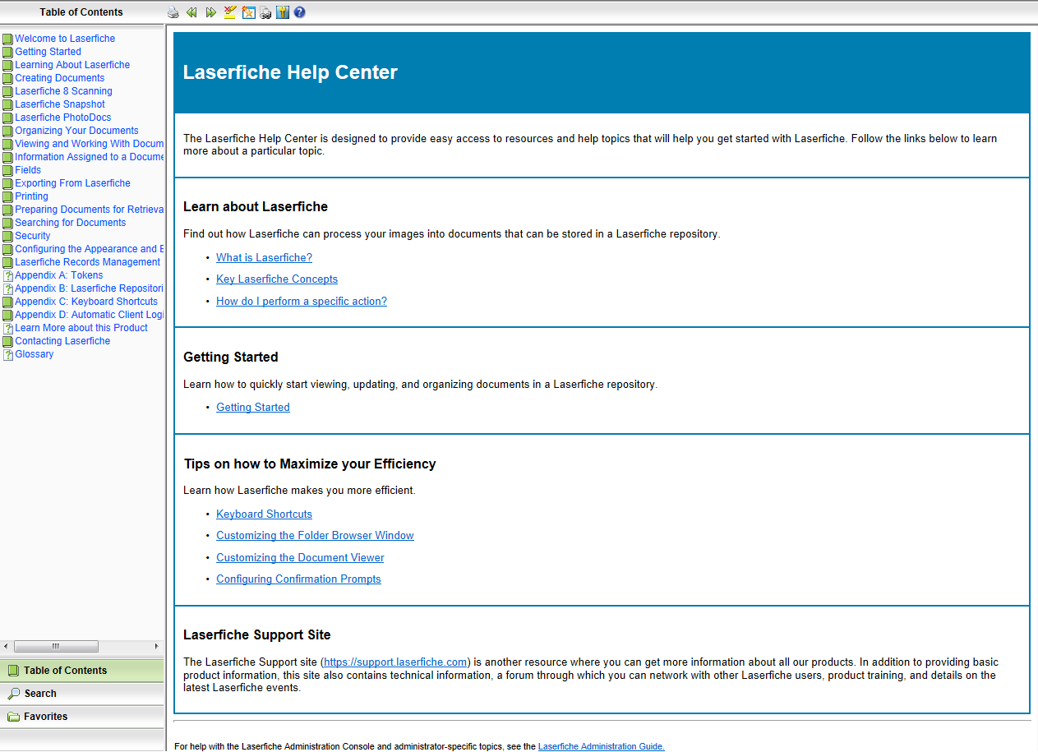
They’re Really Helpful!

Slide 12
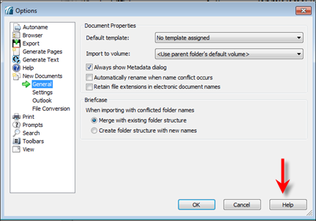
Find Them Here …
F1
Buttons/icons/menus
Context buttons
KB 1012253
Notes:
Many ways to get to them:
F1—in pretty much any Windows program anywhere
Big, shiny help button in toolbar
Help menu at top of screen
Context help on different dialog boxes

Slide 13

The Laserfiche Solution Exchange

Slide 14
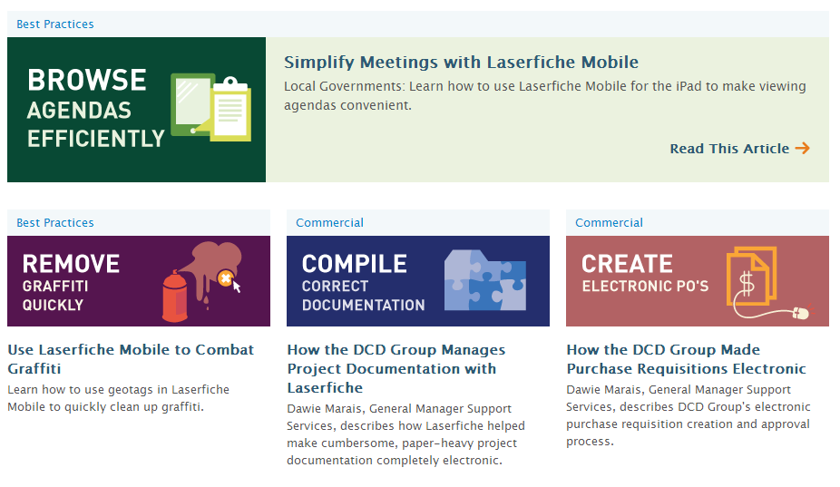
Learn From the Community
Share solutions, tips and tricks
What have others done?
140+ real results that you can learn from

Slide 15
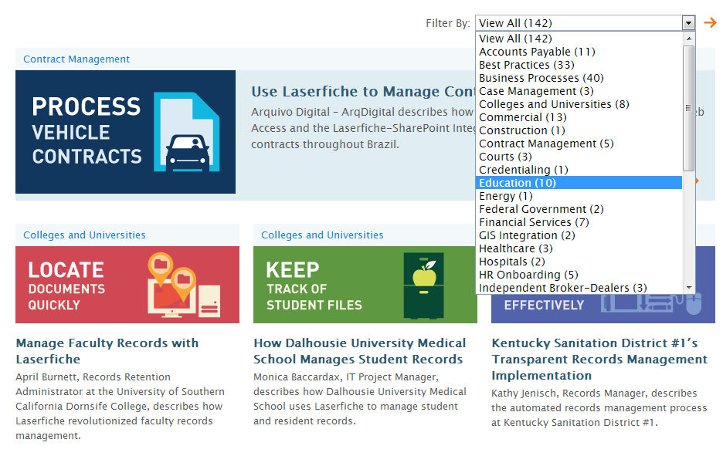

Slide 16

Quicker Better Safer
Written to help both newer and long-time Laserfiche customers across industries get the most out of the software
Covers how to use Laserfiche for common processes such as accounts payable, case management, contract management and much more

Slide 17

Quicker Better Safer: Laserfiche Forms
Learn how to set up and configure Laserfiche Forms for five daily business processes, including:
  Purchase orders
  Travel requests
  Employee hiring and onboarding
  Employee evaluations
  New customer onboarding

Slide 18

Quicker Better Safer: Laserfiche Mobile
Learn how to:
  Implement Laserfiche Mobile within your organization
  View council agendas on iPads
  Participate in business processes on the go
  Configure Laserfiche Mobile security
  And more!

Slide 19

Quicker Better Safer: Accounts Payable
Screenshots and diagrams alongside detailed, step-by-step instructions provide an in-depth look into how ten organizations streamlined the accounts payable process with Laserfiche

Slide 20
What Would You Like to See Next?
Records Management?
HR?
Getting Started?
Email joanna.slusarz@laserfiche.com

Slide 21

The Certified Professional Program

Slide 22
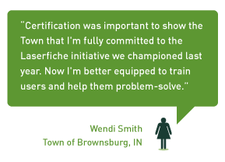

Why Get Certified?

Slide 23

If I Can Do It …

Slide 24

How Does it Work?
Series of self-paced online training videos
Comprehensive training manual
Two opportunities to take the online exam

Slide 25
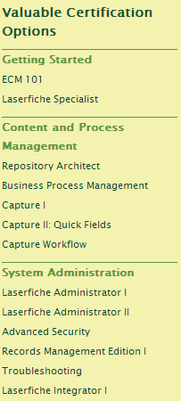
What Certifications are There?

Slide 26

What Certifications are Right for Me?
Scanner/Operator:
  Capture I & II
  Laserfiche Specialist
  Capture Workflow
  BPM*

Slide 27

What Certifications are Right for Me?
Super User:
  ECM 101
  Laserfiche Specialist
  Capture Workflow

Slide 28

What Certifications are Right for Me?
Records Manager:
  Records Management I
  Laserfiche Specialist

Slide 29

Laserfiche Admins: Go for the Gold!

Slide 30

Stay Tuned …
BPM II: Laserfiche Forms
All-new Laserfiche Integrator

Slide 31



Slide 32

New for Empower 2014
Recommended Agendas
  By role:
    New/Experienced User
    New/Experienced Workflow Designer
    Capture Expert
    Records Manager
    New/Experienced Administrator
    Troubleshooter

Slide 33
New for Empower 2014
Recommended Agendas
  By goal:
    What’s New
    How People Use Laserfiche
    Process Improvement
    Web Deployment
    Security
    System Performance

Slide 34
New for Empower 2014
Recommended Agendas
  By product:
    Forms
    Quick Fields
    Workflow

Slide 35

New for Empower 2014
Lunchtime Q&As
New ACT track
Solutions & Partner classes integrated into applicable tracks

Slide 36

Networking Opportunities
Welcome Reception
Texas User Group
Higher Education “Birds of a Feather” Lunches
Special Event
Exciting new things I can’t tell you about (shhh …)

Slide 37
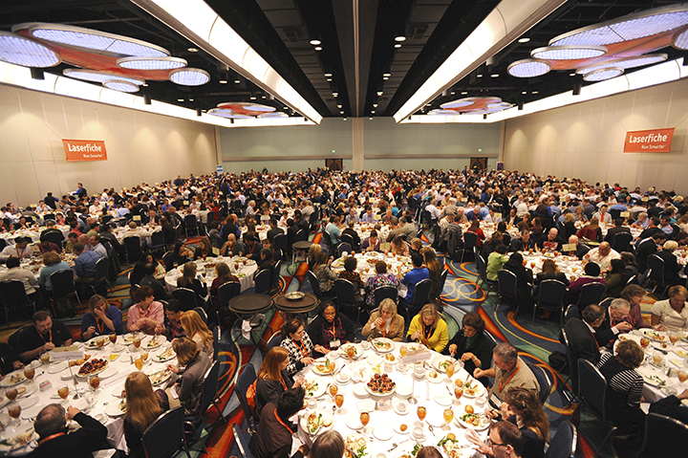
See You in Anaheim!

Slide 38
Questions?

Slide 39
Melissa Henley melissa.henley@laserfiche.com
(562) 988-1688 x230
Pieter Nauta
pnauta@laserfiche.com
(562) 988-1688 x179

